Slide 1

Book Week 2023

Slide 2
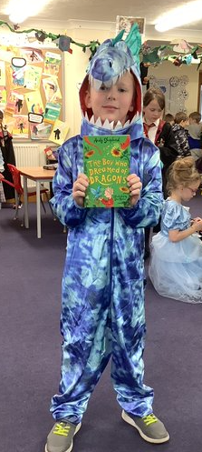
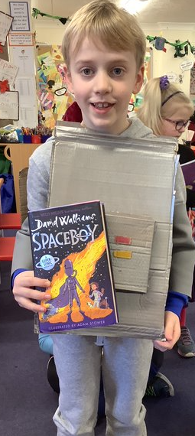
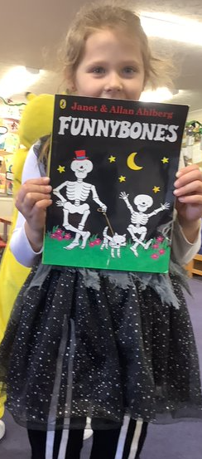
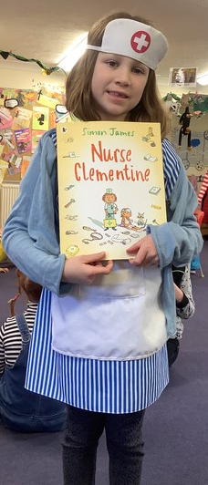
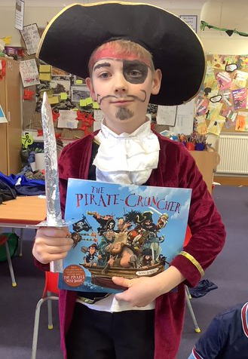
Some of our favourite books from home

Slide 3
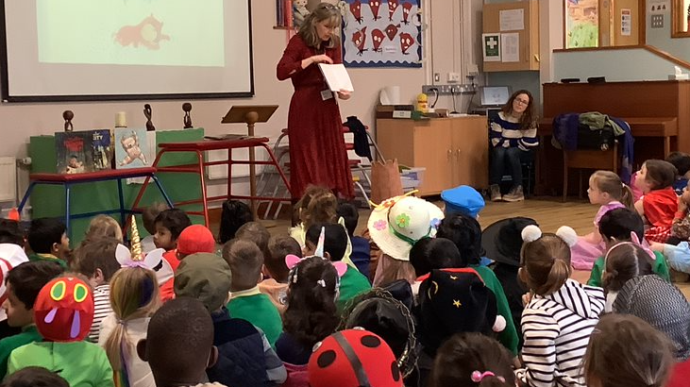
Author, Teresa Heapy, inspires the Year 2 children with her stories!

Slide 4
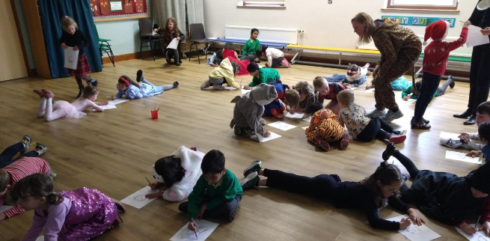
Year 1 children make up their own characters
after listening to
“The Very little Red Riding Hood”
by Teresa Heapy.

Slide 5
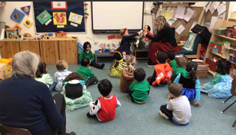
Tulip class meet author, Teresa Heapy and her puppets.

Slide 6
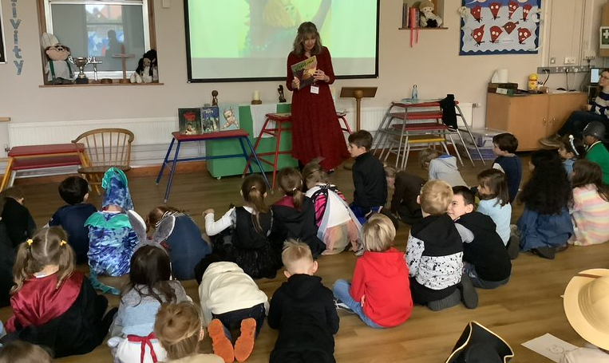

Slide 7
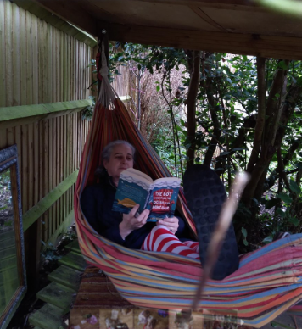
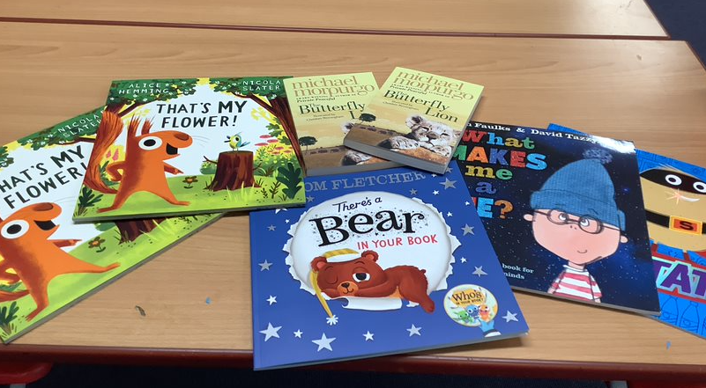
Extreme Reading Competition winners
received a new book as their prize.
Even staff did some extreme reading!
Thank you Mrs Langdon☺

Slide 8
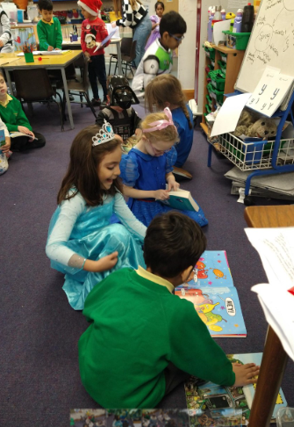
Year 1 children enjoyed sharing books with
friends on dress up day

Slide 9
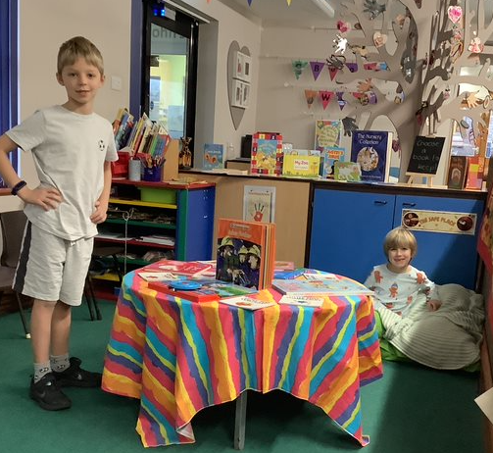
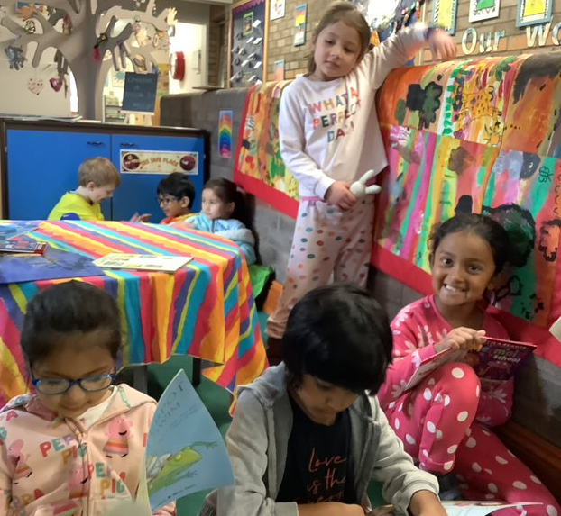
On Friday we had a Bedtime story day
so, of course we wore our pyjamas!
Book Swap Shop was run by Year 2 children.

Slide 10

Thank you to everyone
who helped make it a
super week!.

