Slide 1


Slide 2

Doodle Maths
Doodle Tables
Doodle builds confidence and ability in maths by creating every child a personalised work programme tailored to their strengths and weaknesses. Using Doodle for just 10 minutes a day is proven to help children make three months of progress in just one month!

Slide 3
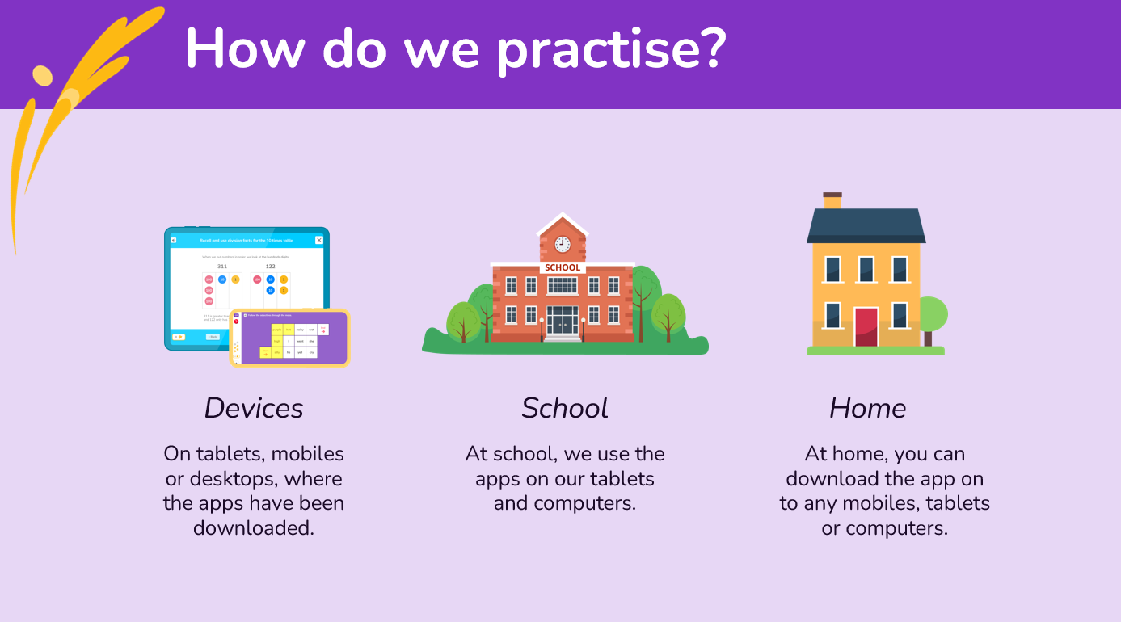

Slide 4
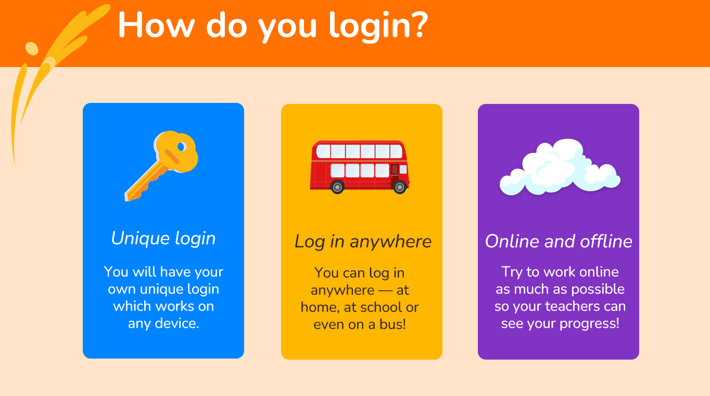

Slide 5
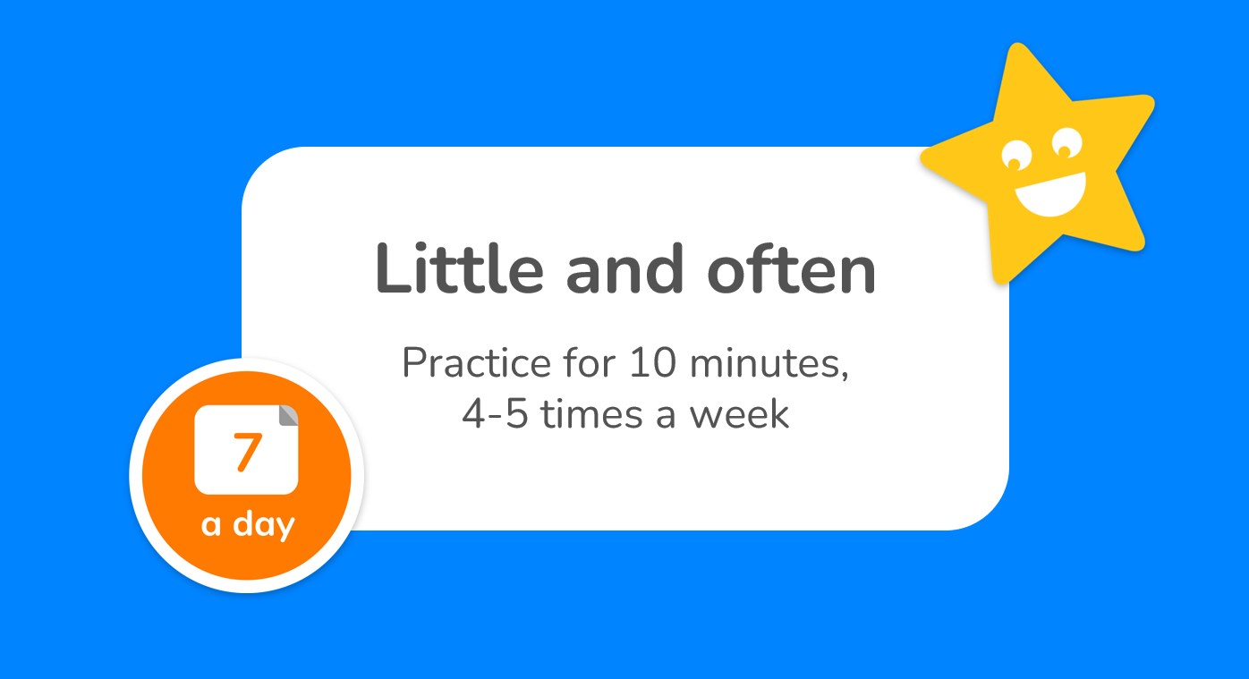

Slide 6


Slide 7
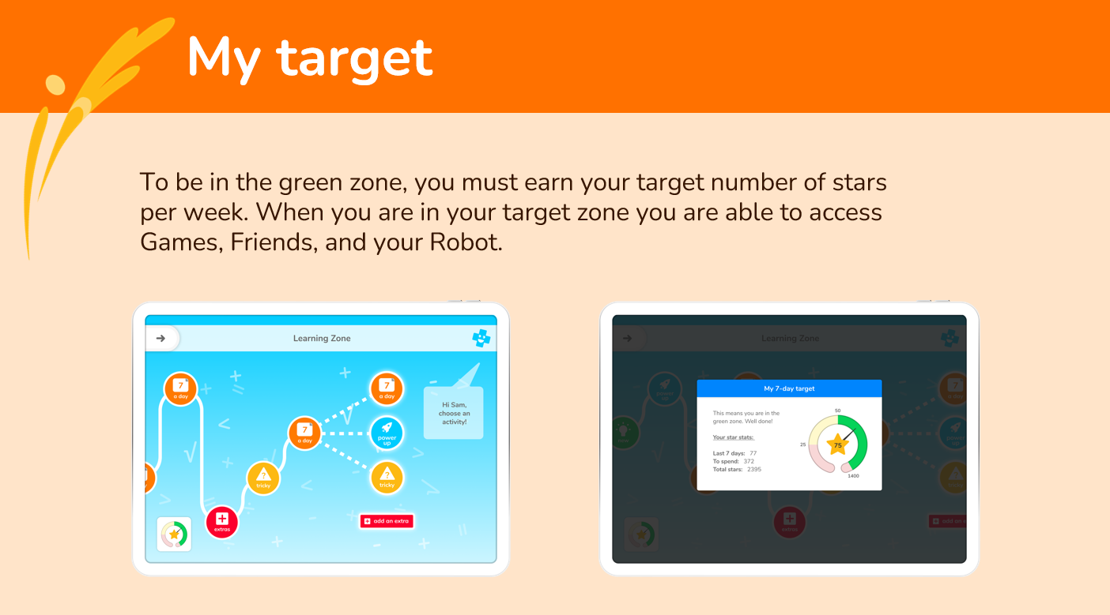

Slide 8
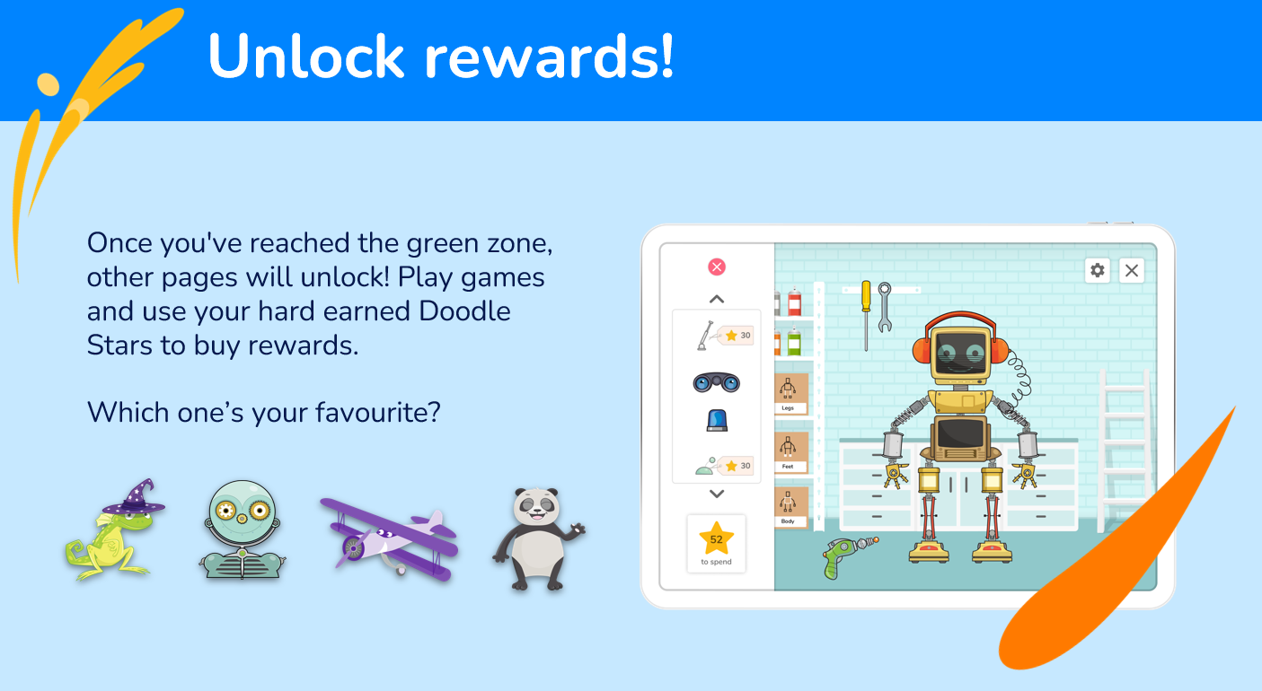

Slide 9


Slide 10
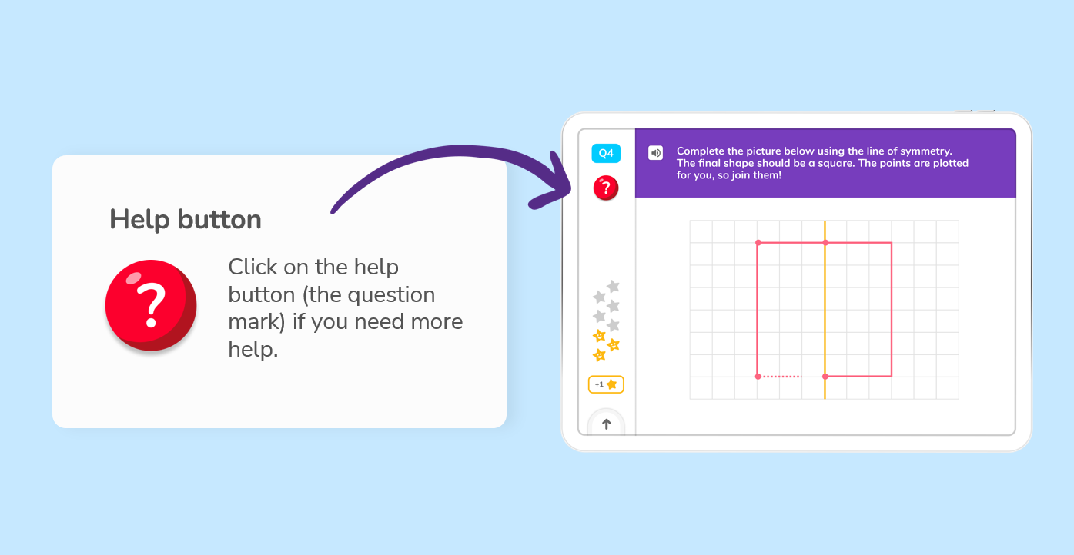

Slide 11
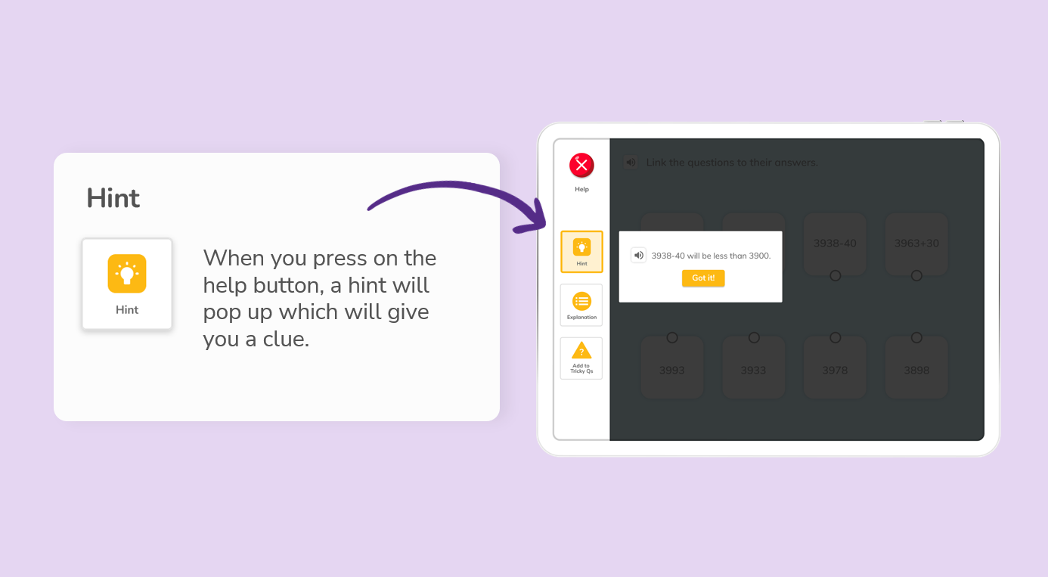

Slide 12
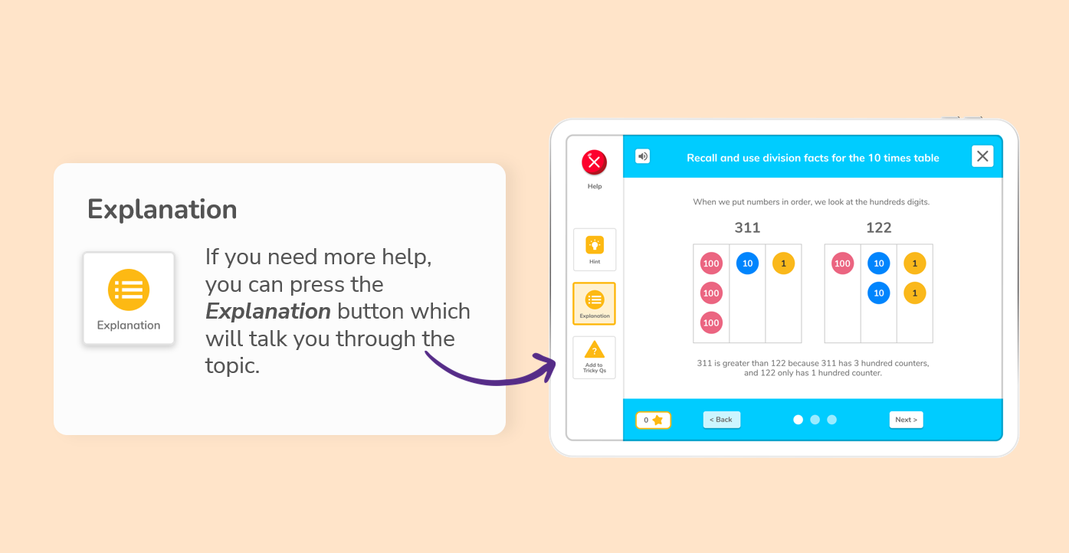

Slide 13
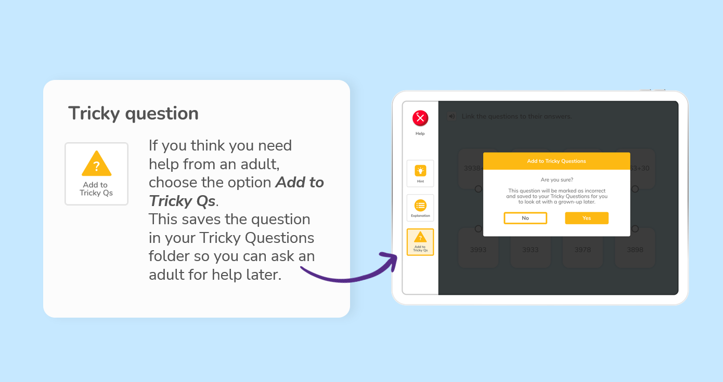

Slide 14
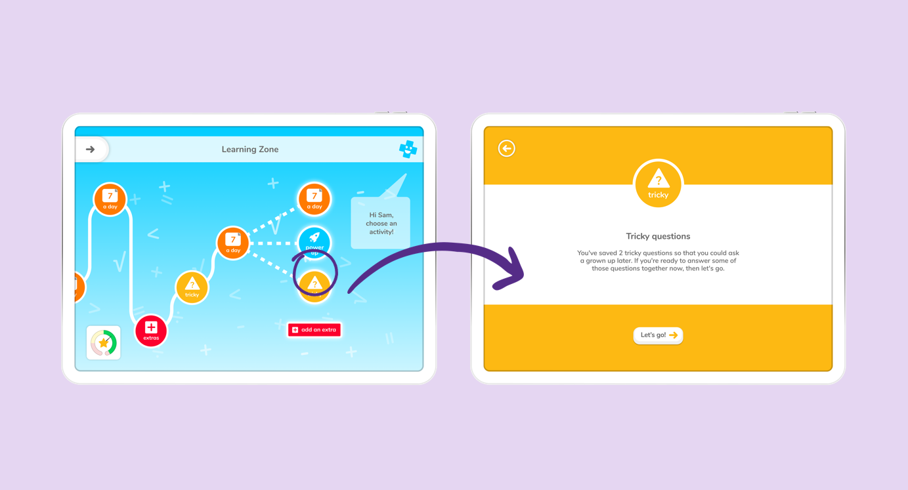

Slide 15

https://vimeo.com/506143677

