Slide 1
SATs
Information Evening
Thursday 23rd April 2026

Slide 2
Objectives
Provide information on Year 6 SATs
Discuss Year 6 teacher assessment
Talk about how you can help your child achieve

Slide 3
School Vs National Results 2025
 | School (expected) | National (expected) | School (greater depth) | National (greater depth)
Reading (Test) | 83% | 75% | 43% | 34%
Grammar (Test) | 74% | 73% | 28% | 29%
Maths (Test) | 69% | 74% | 40% | 26%
Writing (teacher assessment) | 55% | 72% | 0% | 13%

Slide 4
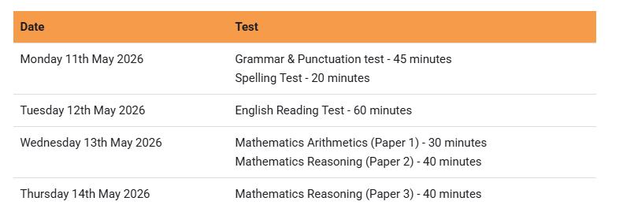
SATs timetable 2026

Slide 5
Reading
Teacher assessment only for those working below the standard of the tests.
Children working below the standard and not able to access the tests
Reading Test
1 Hour
Reading booklet and answer booklet
50 marks available

Slide 6
Reading
Range of scale scores:
3 marks: 80
15 marks: 90
29 marks: 100 (expected standard)
41 marks: 110 (high score)

Slide 7
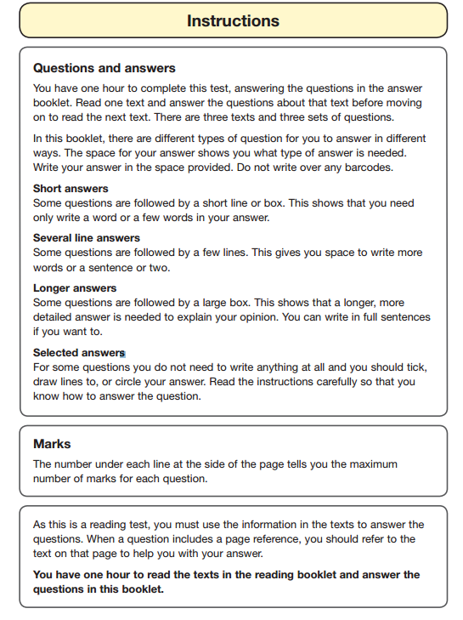

Slide 8
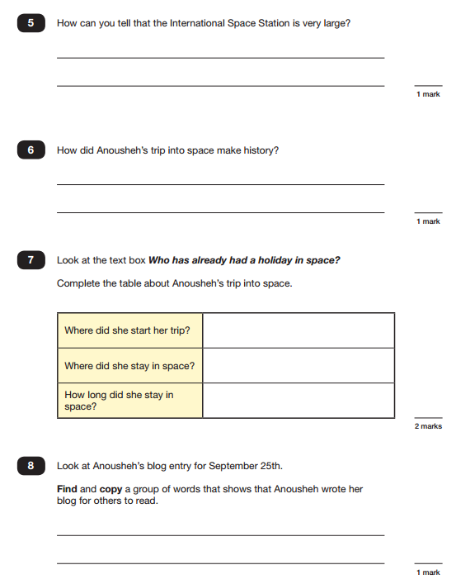

Slide 9
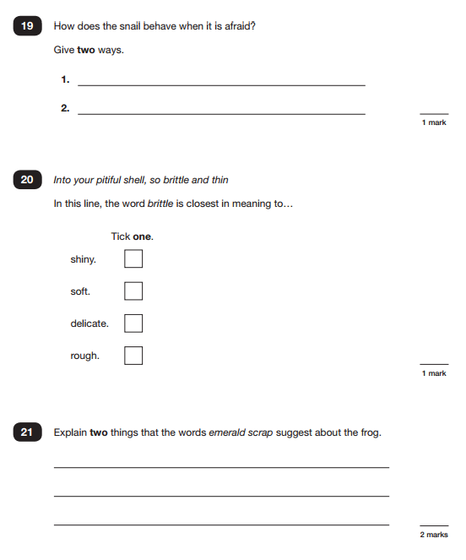

Slide 10
Grammar, punctuation and spelling
Only assessed through a test
2 Papers
Paper 1: Grammar, punctuation and vocabulary
45 minutes
50 marks
Most questions require multiple choice, single word or sentence answers
Importance of accuracy

Slide 11
Grammar, Punctuation and Spelling
Paper 2
Spelling Test
20 Words
All given with a context
Last year St Nic’s average score in spelling test was 12 out of 20

Slide 12
Grammar, Punctuation and Spelling
Range of scale scores:
  3 marks: 80
  15 marks: 90
  35 marks: 100 (expected standard)
  55 marks: 110 (high score)

Slide 13
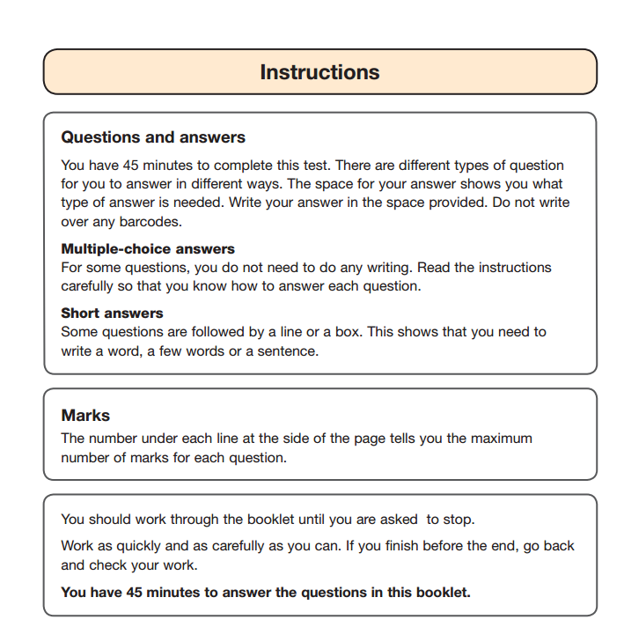

Slide 14
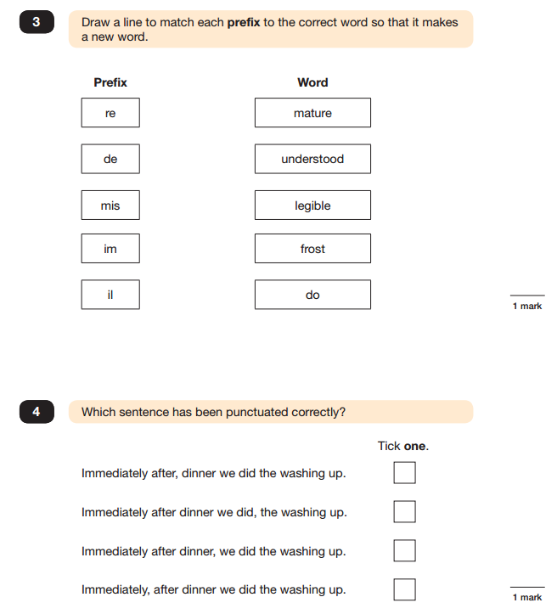

Slide 15
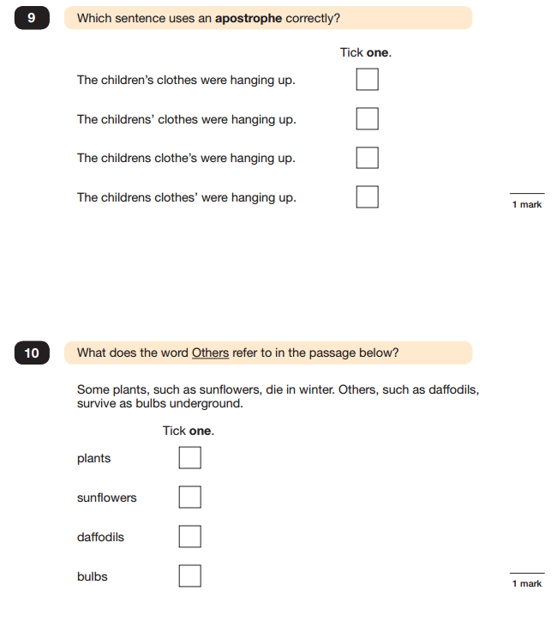

Slide 16
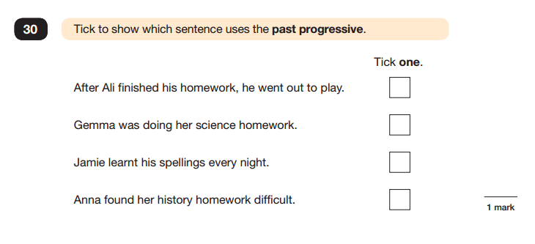

Slide 17
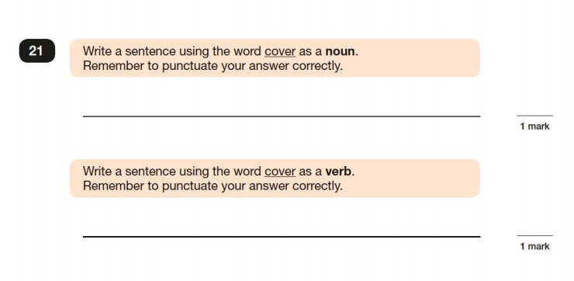

Slide 18
Mathematics
Teacher Assessment only for those below the standard of the test
Children below the standard of the test
Maths tests: 3 papers
Paper A: Calculation 30 minutes: 40 marks.
Paper B: Reasoning 40 minutes: 35 marks
Paper C: Reasoning 40 minutes: 35 marks

Slide 19
Mathematics
Range of scale scores:
3 marks: 80
19 marks: 90
58 marks: 100 (expected standard)
96 marks: 110 (high score)

Slide 20
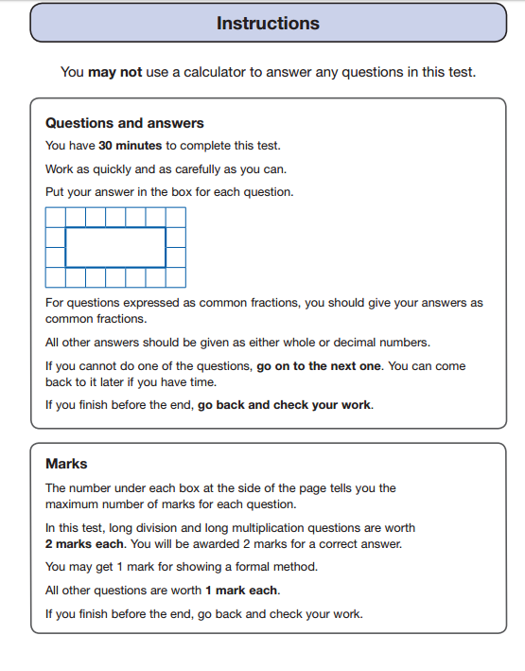

Slide 21
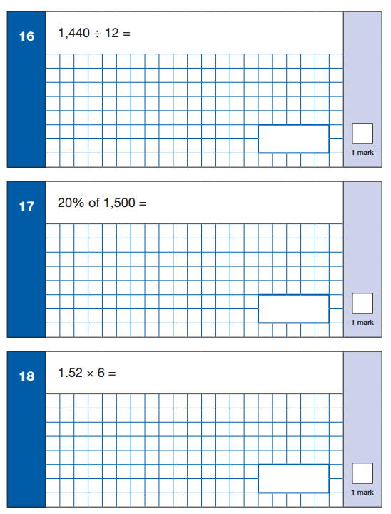

Slide 22
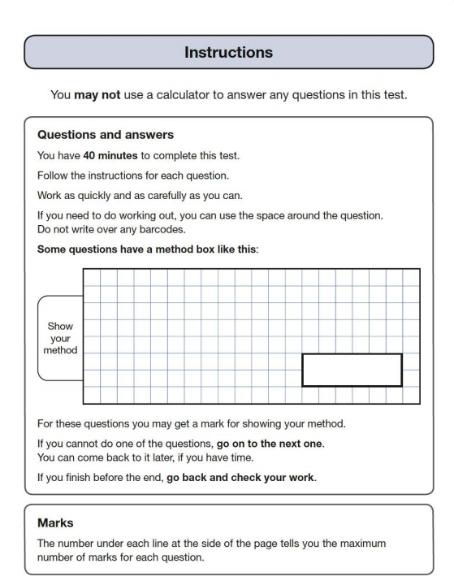

Slide 23
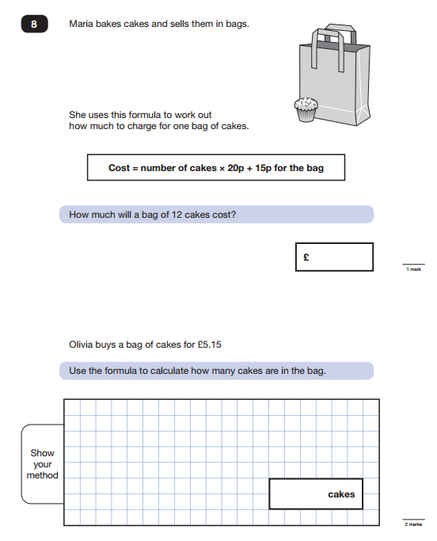

Slide 24
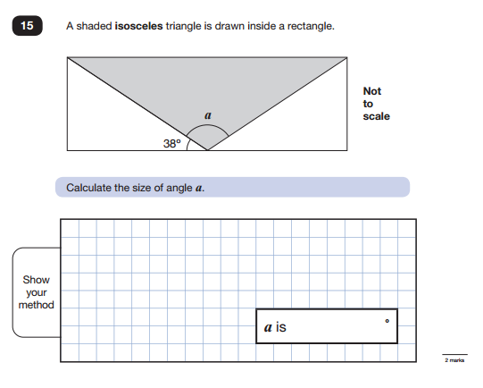

Slide 25
Writing
  Teacher assessment:
    3 teacher assessment standards
    The three standards in this framework contain a number of ‘pupil can’ statements. To judge that a pupil is working at a standard in English writing, teachers need to have evidence which demonstrates that the pupil meets the standard described overall.
      Working towards the expected standard
      Working at the expected standard
      Working at greater depth within the expected standard

Slide 26
Writing
A pupil’s writing should meet all the statements within the standard at which they are judged. However, teachers can use their discretion to ensure that, on occasion, a particular weakness does not prevent an accurate judgement being made of a pupil’s attainment overall. A teacher’s professional judgement about whether the pupil has met the standard overall takes precedence. This approach applies to English writing only.
• A particular weakness could relate to a part or the whole of a statement (or statements), if there is good reason to judge that it would prevent an accurate judgement being made.

Slide 27
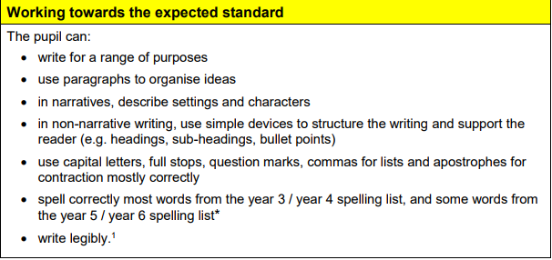

Slide 28
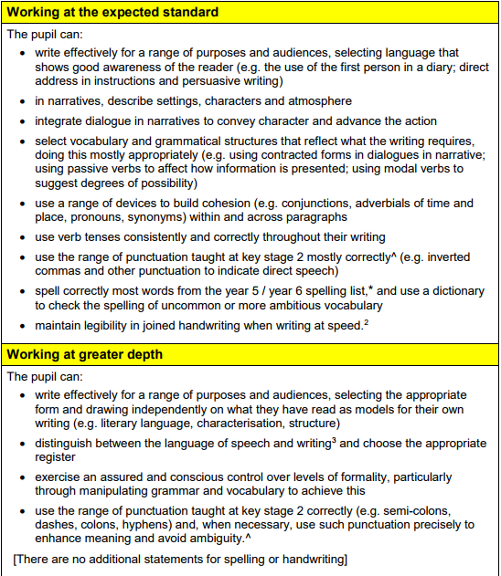

Slide 29
What information will be given to parents?
For each test:
a raw score (the number of marks awarded)
a scaled score
and confirmation of whether or not they attained the expected standard
Teacher assessment result for writing indicating whether the expected standard has been met, or whether a child is working at greater depth, working towards etc.
Teacher assessment result for science indicating only whether the standard has been met or not.

Slide 30
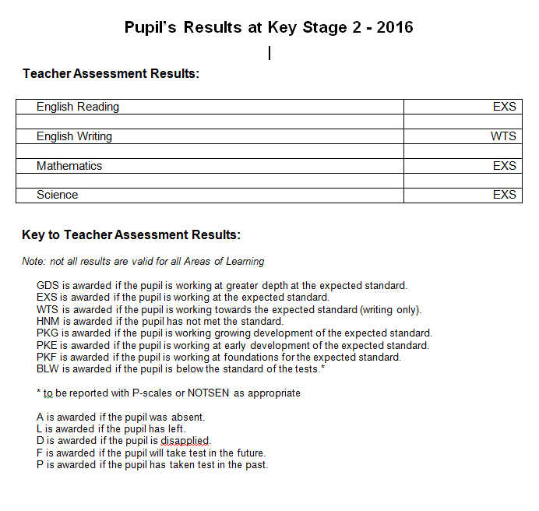

Slide 31
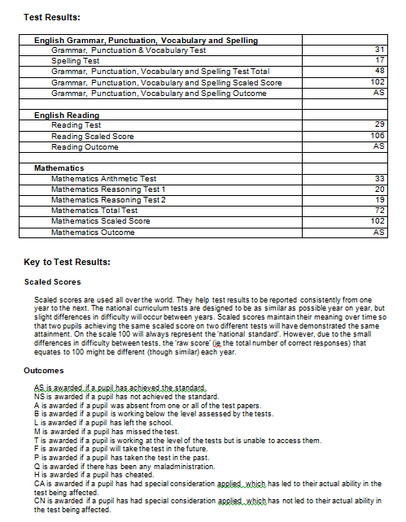

Slide 32
Which children will sit tests?
The tests are designed to be used with all pupils who are working at the standard of the national curriculum. There will be some pupils who will be working below the ‘expected standard’ of the test, who will not achieve a scaled score of 100, but who should still take the tests. Teachers should use their knowledge of each pupil to decide whether to administer the tests to them.

Slide 33
Will there still be access arrangements?
Schools are responsible for making arrangements to determine whether a pupil is working at the standard of the tests but is unable to access them.
Access arrangements are adjustments that schools must consider before the tests. They should be based primarily on normal classroom practice for pupils with particular needs. Access arrangements must never provide an unfair advantage. The support given must not change the test questions and the answers must be the pupil’s own.
Access arrangements may be appropriate for pupils:
with a statement of SEN or an Education Health and Care Plan as described in the SEN Code of Practice at www.gov.uk/government/publications/special-educational-needssen-code-of-practice or a local equivalent
for whom provision is being made in school using the SEN Support system and whose learning difficulty or disability significantly affects their ability to access the tests
who requires alternative access arrangements because of a disability (which may or may not give rise to a special educational need)
who is unable to sit and work for a long period because of a disability or because of social, emotional or mental health difficulties
with EAL and who has limited fluency in English
Schools must make sure they have documentation to show that a pupil is eligible for access arrangements. This must include evidence that resources are routinely committed to providing this support in the classroom. Schools must be able to show the documentation if they have a monitoring visit. If schools use access arrangements for a pupil inappropriately, the pupil’s results may be annulled.

Slide 34
Access Arrangements
Reader
Scribe
Extra time
Breaks
Parents will be informed

Slide 35
How can parents help to prepare children?
School homework:
  Daily reading
  Weekly English and Maths homework
  Weekly spellings homework
  Revision books – available in bookshops and online – not necessary, but some parents like to do this.

Slide 36
Any Questions?

