Slide 1
Parent Information Meeting
Year 3 and 4

Slide 2
Our aim for every child
Every child to achieve expected standards in reading, writing and maths
Regular reading at home and school – guided reading, reading with an adult
Ensure basics of writing are in place – handwriting, spelling, punctuation, understanding of a sentence
Secure knowledge of number including place value, number bonds and multiplication tables

Slide 3
What does this mean in Year 3?
VIPERS (Vocabulary, Inference, Prediction, Explanation, Retrieval, Structure, Impact)
Spelling
Handwriting and presentation: joining letters; legibility

Slide 4
What does this mean in Year 3?
Correct use of determiners
Secure use of noun phrases
Use of co-ordinating and subordinating conjunctions
Adverbs and prepositions
Introduce paragraphs
Present perfect form of verbs
Use of nouns or pronouns for clarity and cohesion
Secure use of question marks and exclamation marks
Use apostrophes to separate items in a list
Secure use of apostrophes for contraction and singular possession
Introduction to inverted commas for direct speech

Slide 5
What does this mean in Year 3?
Multiplication tables
Place value
Addition and subtraction
Multiplication and Division
Money
Statistics
Length and Perimeter
Fractions
Time
Properties of Shapes
Mass and Capacity

Slide 6
What does this mean in Year 4?
VIPERS (Vocabulary, Inference, Prediction, Explanation, Retrieval, Summary and comparison, Structure, Impact)
Spelling – Year 3/4 spelling list
Handwriting and presentation

Slide 7
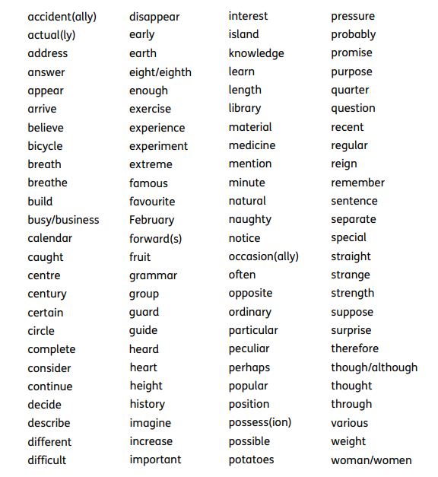

Slide 8
What does this mean in Year 4?
Difference between plural and possessive s
Standard verb inflections
Determiners
Paragraphs
Nouns and pronouns for clarity and to avoid repetition
Inverted commas for direct speech
Commas after a reported clause
Apostrophes for contraction and possession including plurals
Commas after fronted adverbials

Slide 9
What does this mean in Year 4?
Multiplication tables to 12X12 – test in June
Place value
Addition and subtraction
Length and perimeter
Multiplication and division
Area
Fractions
Decimals
Money
Time
Statistics
Properties of shape
Position and direction

Slide 10
Working below; what can I do?
Provide your child with opportunities to practise at home
Focus on basic skills – confident reading at the correct level, spelling, handwriting, letter formation, number bonds, times tables
If you are still concerned, contact Mrs Blakemore via the school office to discuss potential Special Educational Needs

Slide 11
Classroom expectations
All children focused when teacher is talking
Use of whiteboards
Cold calling
Developing questioning
Children explaining their understanding
High expectations for behaviour

Slide 12
Specific reading skills
Opportunities to read at home
Read to an adult
Listen to an adult
Reading of material outside of school books – newspapers, magazines, comics etc.

Slide 13
Specific writing skills
Understanding what a sentence is – talking at home; encouraging writing at home
Focus on letter formation and handwriting
Focus on spelling
Focus on punctuation

Slide 14
Specific maths skills
Number bonds – quick practice of numbers that add up to different amounts; e.g. what do I add to 8 to make 17?
Secure knowledge of multiplication tables to 12X12
Understanding of how the number system works – place value

Slide 15
Helping at home and homework
Lots of opportunities to read and discuss reading
Provide real opportunities for writing – invitations, thank you letters etc. Handwritten rather than on phones/computers
Opportunities for handwriting and spelling practice – ensure weekly homework is done
Lightning Squad for those children working on it
Regular times tables practice at home – use of post-it notes for quick practice and multiplication games
Doodle Maths for Year 4 and above

Slide 16
Communication with teachers
Two parents’ evenings – November and July
Report to parents with targets – April
Opportunities for informal discussion – teachers available each day on playground
Email for concerns about learning

