Slide 1
Parent Information Meeting
Year 5 and 6

Slide 2
Our aim for every child
Every child to achieve expected standards in reading, writing and maths
Regular reading at home and school – guided reading, reading with an adult
Ensure basics of writing are in place – handwriting, spelling, punctuation, understanding of a sentence
Secure knowledge of number including place value, number bonds and multiplication tables

Slide 3
What does this mean in Year 5?
VIPERS (Vocabulary, Inference, Prediction, Explanation, Retrieval, Summary and Comparison, Structure, Impact)
Spelling
Handwriting and presentation: joining letters; legibility

Slide 4
What does this mean in Year 5?
Broaden vocabulary use
Use relative clauses
Use modal verbs or adverbs to indicate degree of possibility
Use prepositional phrases to vary sentence structure
Use adverbials to add detail
Know and use progressive and perfect tense
Link ideas across paragraphs
Use conjunctions to link and build cohesion
Use commas to clarify meaning and avoid ambiguity
Secure use of apostrophes
Secure use of speech punctuation
Introduce brackets, dashes and commas for parenthesis

Slide 5
What does this mean in Year 5?
Multiplication tables
Place value – negative numbers
Addition and subtraction
Multiplication and Division
Fractions
Decimals and percentages
Perimeter and Area
Statistics
Properties of Shapes
Position and Direction
Converting units of time
Volume

Slide 6
What does this mean in Year 6?
VIPERS (Vocabulary, Inference, Prediction, Explanation, Retrieval, Summary and comparison, Structure, Impact)
Spelling – Year 5/6 spelling list
Handwriting and presentation

Slide 7
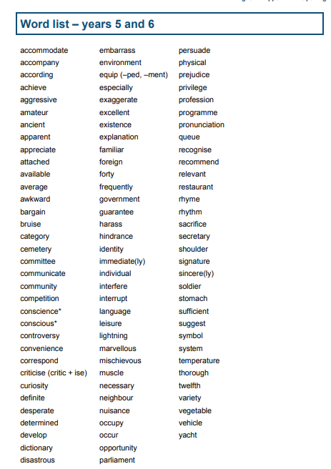

Slide 8
What does this mean in Year 6?
Difference between formal and informal vocabulary and when to use
Use passive verbs to affect the presentation of information in a sentence
Recognise structures that are appropriate for formal writing – subjunctive
Identify and use a range of sentence structures
Use a range of multi-clause sentences for variety and effect
Use a range of cohesive devices to link within and across paragraphs
Use a range of structural features to lay out text in non-fiction writing
Secure use of accurate punctuation including question and exclamation marks
Secure use of brackets, dashes and commas for parenthesis
Use hyphens to avoid ambiguity
using semicolons, colons or dashes to mark boundaries between clauses
Use a colon to introduce a list and semi-colons within lists

Slide 9
What does this mean in Year 6?
Multiplication tables
Place value
Addition and subtraction
Multiplication and division
Fractions
Position and Direction
Ratio
Algebra
Fractions, Decimals and Percentages
Converting units
Statistics
Symmetry and Tessellation

Slide 10
Working below; what can I do?
Provide your child with opportunities to practise at home
Focus on basic skills – confident reading at the correct level, spelling, handwriting, letter formation, number bonds, times tables
If you are still concerned, contact Mrs Blakemore via the school office to discuss potential Special Educational Needs

Slide 11
Classroom expectations
All children focused when teacher is talking
Use of whiteboards
Cold calling
Developing questioning
Children explaining their understanding
High expectations for behaviour

Slide 12
Specific reading skills
Opportunities to read at home
Read to an adult
Listen to an adult
Reading of material outside of school books – newspapers, magazines, comics etc.

Slide 13
Specific writing skills
Understanding what a sentence is – talking at home; encouraging writing at home
Focus on letter formation and handwriting
Focus on spelling
Focus on punctuation

Slide 14
Specific maths skills
Number bonds – quick practice of numbers that add up to different amounts; e.g. what do I add to 8 to make 17?
Secure knowledge of multiplication tables to 12X12
Understanding of how the number system works – place value

Slide 15
Helping at home and homework
Lots of opportunities to read and discuss reading
Provide real opportunities for writing – invitations, thank you letters etc. Handwritten rather than on phones/computers
Opportunities for handwriting and spelling practice – ensure weekly homework is done
Lightning Squad for those children working on it
Regular times tables practice at home – use of post-it notes for quick practice and multiplication games
Doodle Maths and above

Slide 16
Communication with teachers
Two parents’ evenings – November and July
Report to parents with targets – April
Opportunities for informal discussion – teachers available each day on playground
Email for concerns about learning

