Slide 1
Phonics Screening Check 2025

Slide 2
Why is phonics so important?
Building blocks of reading
Phonics has a positive impact overall (+5 months) with very extensive evidence and is an important component in the development of early reading skills, particularly for children from disadvantaged backgrounds.
The teaching of phonics should be explicit and systematic to support children in making connections between the sound patterns they hear in words and the way that these words are written.
Once children understand phonics, it strongly supports their ongoing reading development

Slide 3
Why Year 1
Children have been in school for two years
All had an opportunity to follow phonics programme throughout that time
To be successful in future reading, children need to be able to physically read
Reading is the single most important skill that reflects on all future learning

Slide 4
Barriers and Keys
Attendance
Reading at home
Parental aspiration
Home language
Special Educational Needs

Slide 5
What is the phonics screening check?
Check to allow teachers to assess children’s developing phonic knowledge to ensure that children are able to read words and that they are on track to become fluent readers who can enjoy reading for pleasure and learning
National assessment for all Year 1 children and Year 2 children who didn’t achieve the expected standard in Year 1
This year w/b 9th June 2025
40 words to read – 20 real words and 20 pseudo/alien/nonsense words
Children work individually with teacher starting with practise words

Slide 6

Pseudo/Alien/Nonsense words
Included because they are new to all children and assess whether a child can decode using phonic skills and not their memory
Phonically decodable and have an alien picture to show not real words
During phonics lessons children regularly read nonsense words

Slide 7
What will it check?
Children can sound out and blend graphemes in order to read simple words
Read phonetically decodable one-syllable and 2 syllable words e.g. cat, sand, windmill
Read a selection of nonsense words

Slide 8
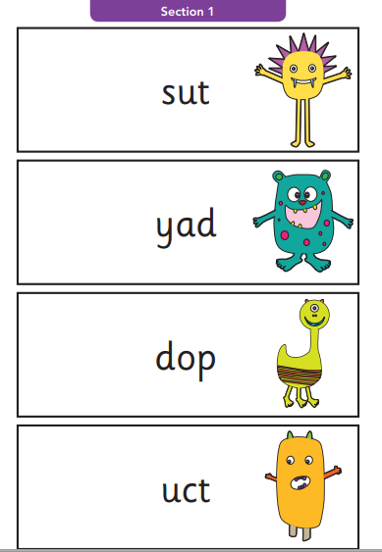
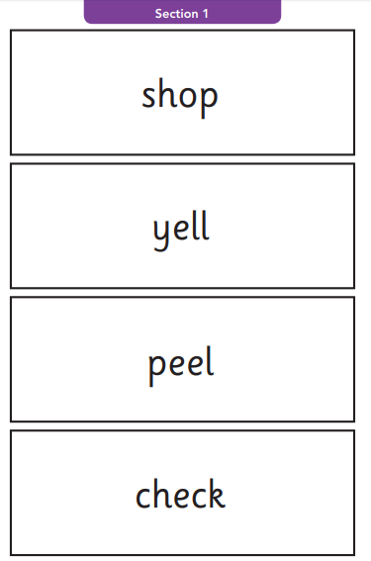
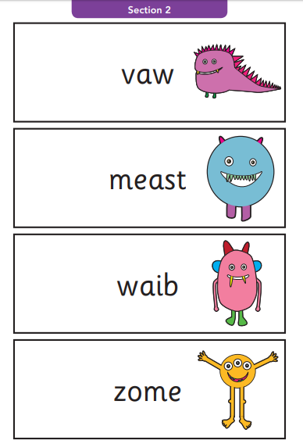
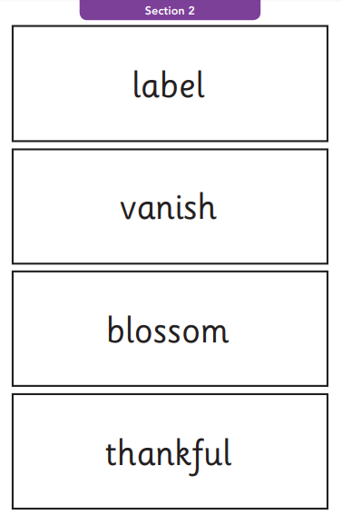
What will it look like to the children?
Section 1
Section 2
12 ‘nonsense’ words.
8 real words.
8 ‘nonsense’ words.
12 real words.
20 words
single letters (a, b, c, d, e, f, g, h, I, j, k, l, m, n, o, p, q(u), r, s, t, u, v, w, x, y, z)
some consonant digraphs (ch, ck, ff, ll, ng, sh, ss, th, zz)
frequent and consistent vowel digraphs (ar, ee, oi, oo,or)
20 words
additional consonant digraphs (ph, wh)
less frequent and consistent vowel digraphs, including split digraphs (a-e, ai, au, aw, ay, ea, e-e, er, ew, i-e, ie, ir, oa, o-e, ou, ow, oy, ue, u-e, ur)
trigraphs (air, igh).

Slide 9
How will we help in school?
Ongoing systematic phonics teaching and daily reading teaching
Additional phonic opportunities each week
Support groups for identified children
Discussions with individual parents

Slide 10
What if my child doesn’t achieve the standard?
Lightning Squad
Retake in Year 2
Ongoing support in Year 3
Special Educational Needs Register

Slide 11
How can you help at home?
At home you can continue to read as much as possible with your child.
Ensure that your child is segmenting and blending unknown words when they are reading.
E.g. Shirt –
Segment it = Sh – ir – t
Blend it = Shirt.
It is important that you encourage your child to blend the word once they have segmented it as marks can’t be given if words are not fully blended in the check.

Slide 12
Lightning Squad at Home
All children, who have Lightning Squad intervention can access this at home
Strong benefit to supporting phonics screening achievement

Slide 13
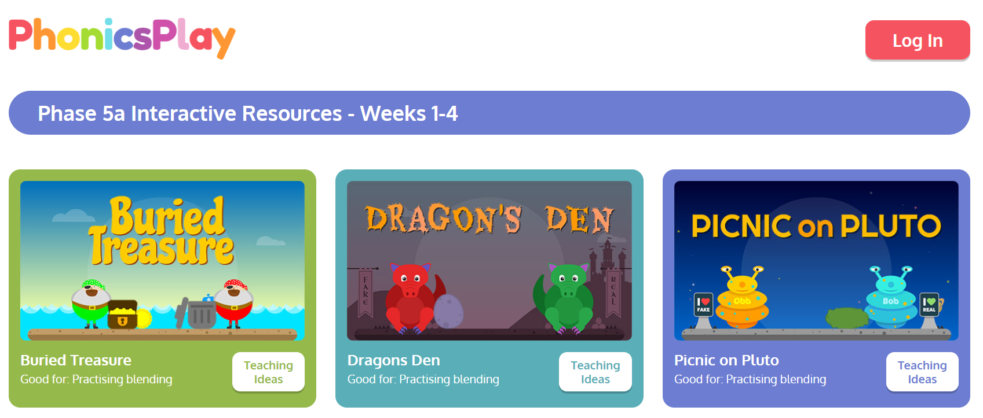
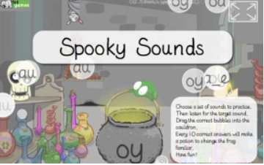
Games! Fun ways to practise phonics
Phonics Play
These are the games which you can play that do not require a subscription. We have played these games in class so the children are familiar with them!
https://www.phonicsplay.co.uk/resources/phase/5
Spooky Sounds
Children to identify digraphs and split digraphs from a range of other digraphs.
https://www.ictgames.com/mobilePage/spookySounds/index.html
You can find other Phonics games on Top Marks as well;
https://www.topmarks.co.uk/english-games/5-7-years/letters-and-sounds

Slide 14
Any questions?

