Slide 1
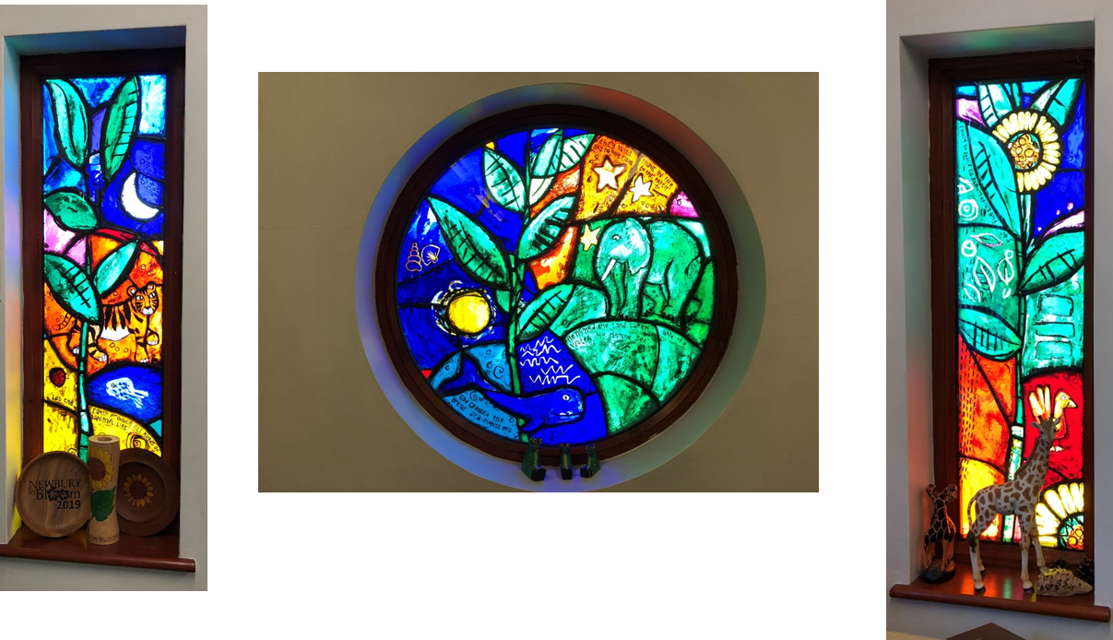
Meeting for New Reception Parents
22nd June 2026

Slide 2
Our Vision
For the good of all – through curiosity, creativity and love

Slide 3
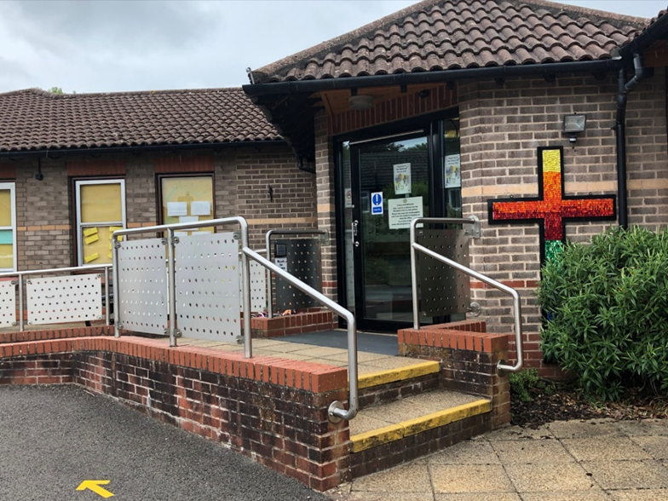
About the school
2 form entry
Nurture at our heart
Learning and progress
Core curriculum
Breadth of opportunity
Christian values

Slide 4
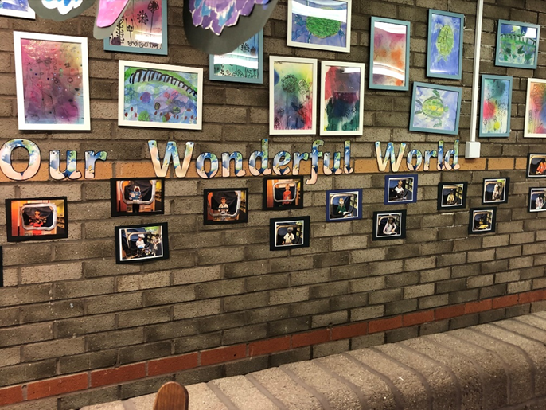
What makes St John’s Special?
Care and nurture for every child
  Family support worker
  ELSA
  SENCO
Quality foundation stage provision
Challenging and enjoyable curriculum
Dedicated staff
Safe and secure infant environment

Slide 5
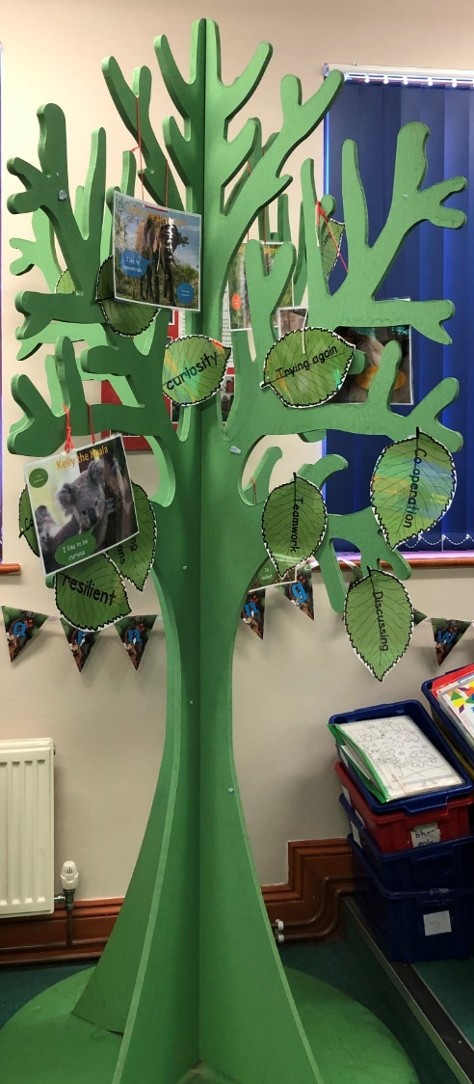
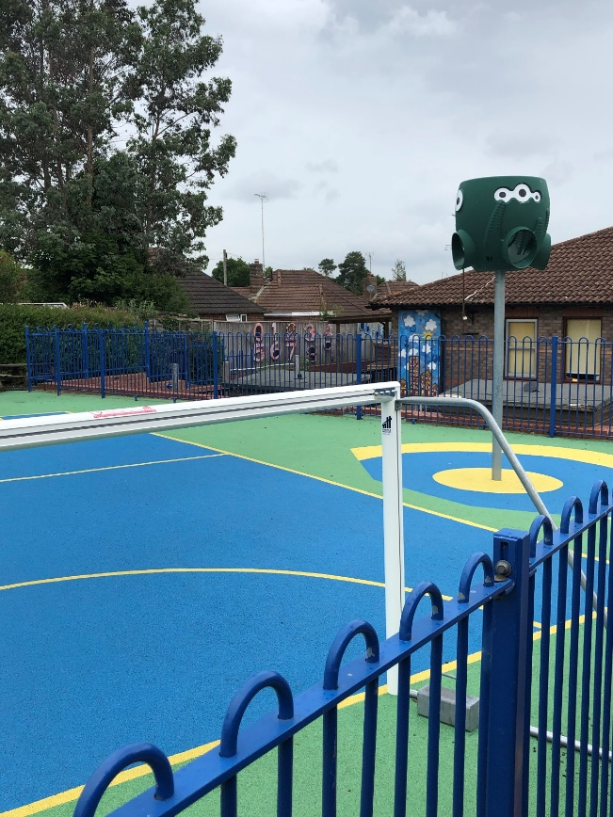
Our aims
Reading and phonics
Writing
Maths
Pastoral

Slide 6
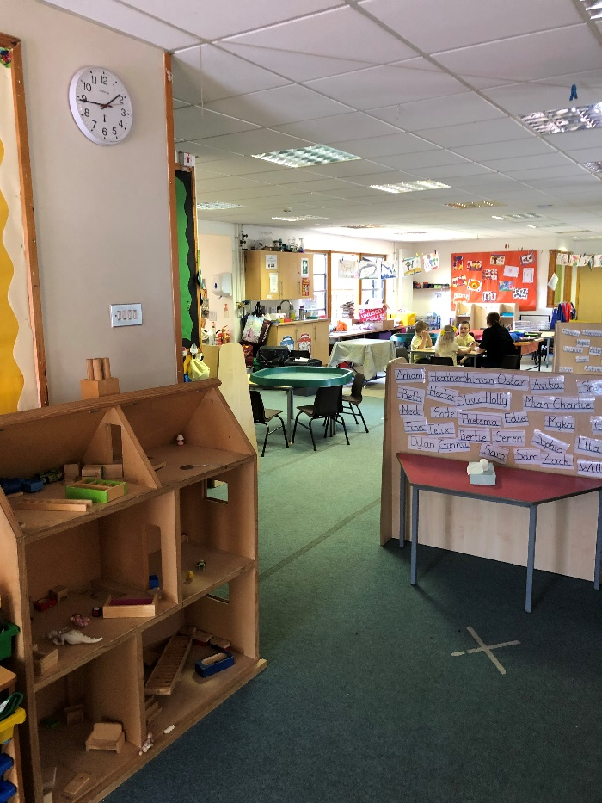
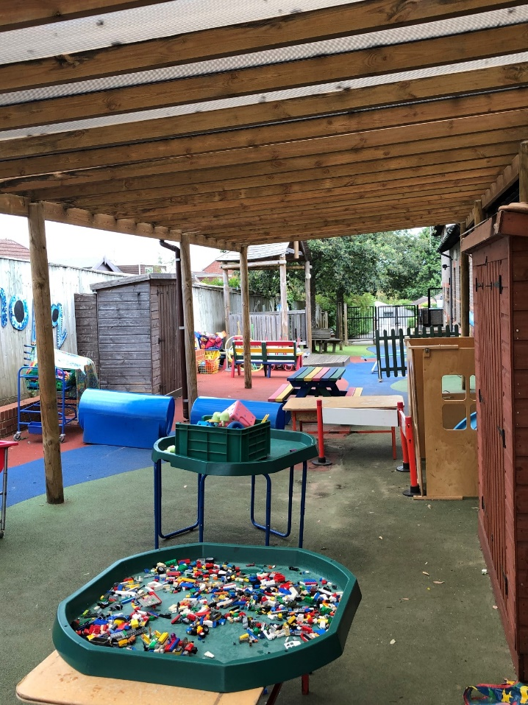
Behaviour
High expectations
Encourage pro-social behaviour
Focus on small things
Develop whole school feeling

Slide 7
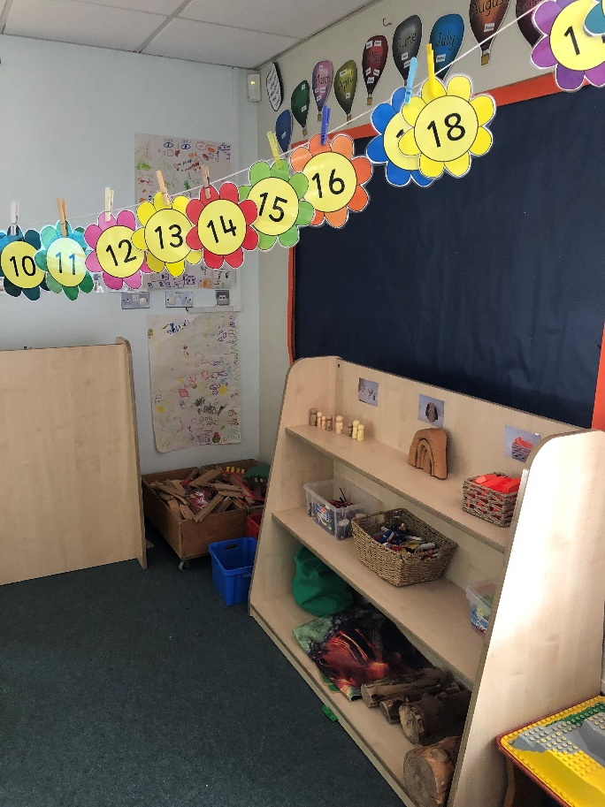
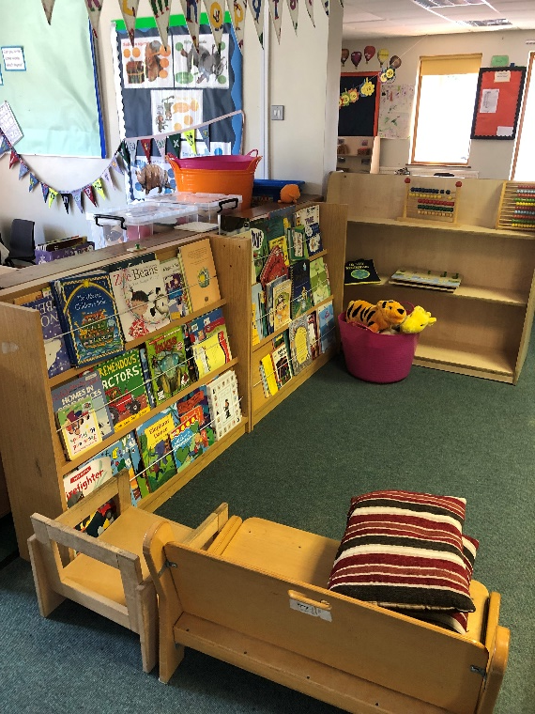
Additional support
Special Educational Needs
Pupil premium
English as an Additional Language
Other needs

Slide 8
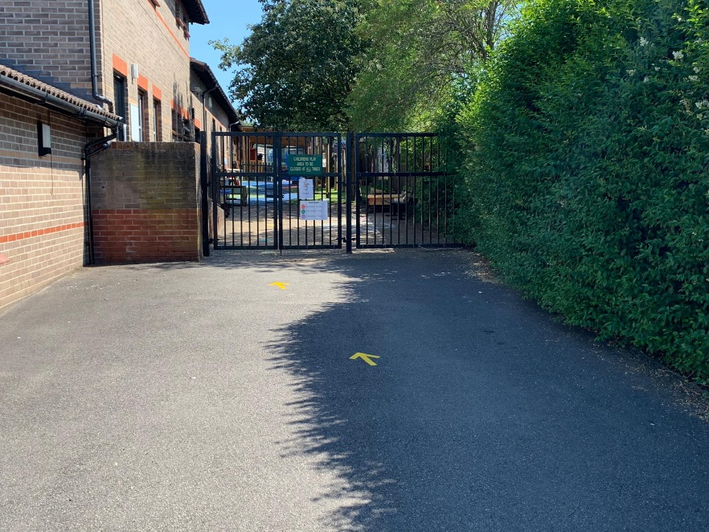
Attendance
Evidence shows that high attendance leads to higher attainment and progress
5 days off school per term is equivalent to over one year of lost learning across a child’s school life.
We expect children to be in school
We do not authorise family holidays – fixed penalty notice

Slide 9
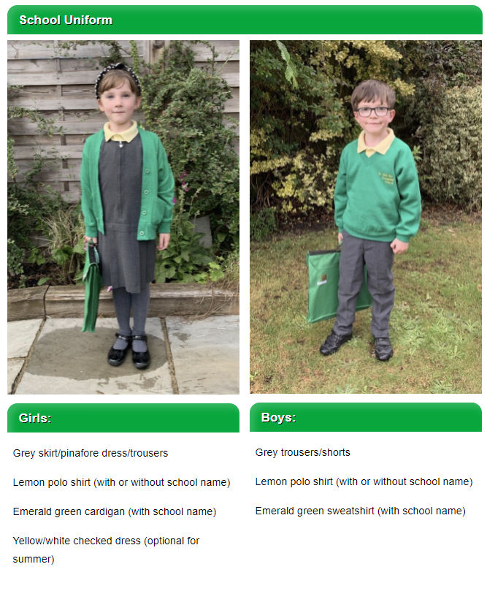
Uniform

Slide 10
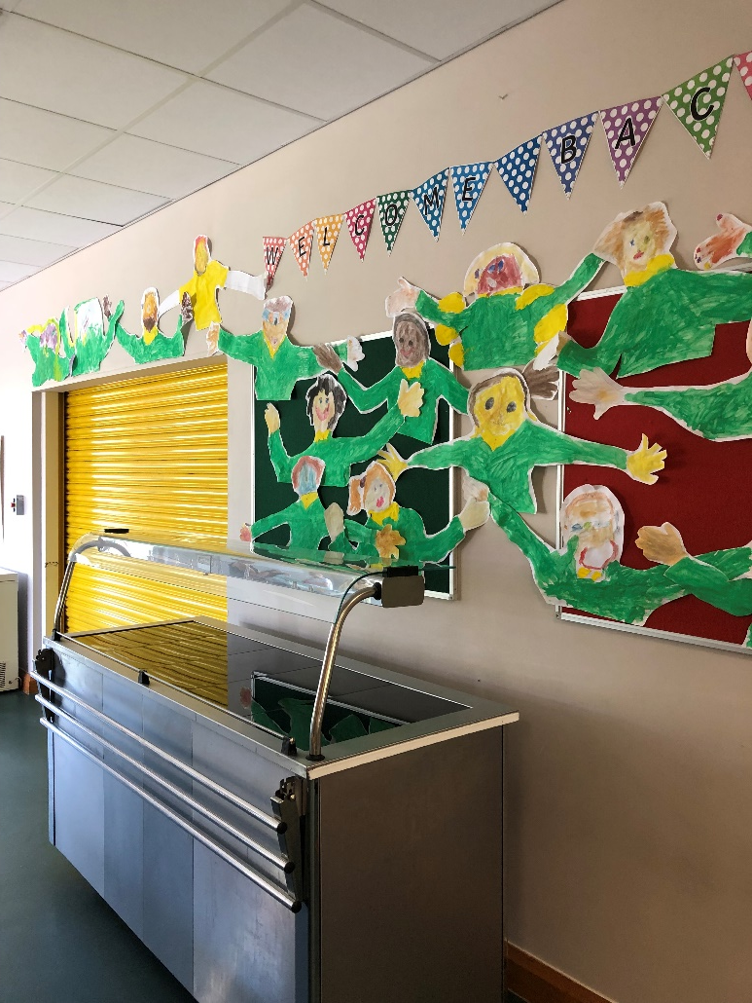
Food
Kitchen team employed by school
Own menu that children enjoy eating
Universal free school meals

Slide 11
What is the Early Years Foundation Stage ( E.Y.F.S)?
The E.Y.F.S. is the stage of education for children from birth to the end of the Reception year.
It is based on the recognition that children learn best through play and active learning.

Slide 12
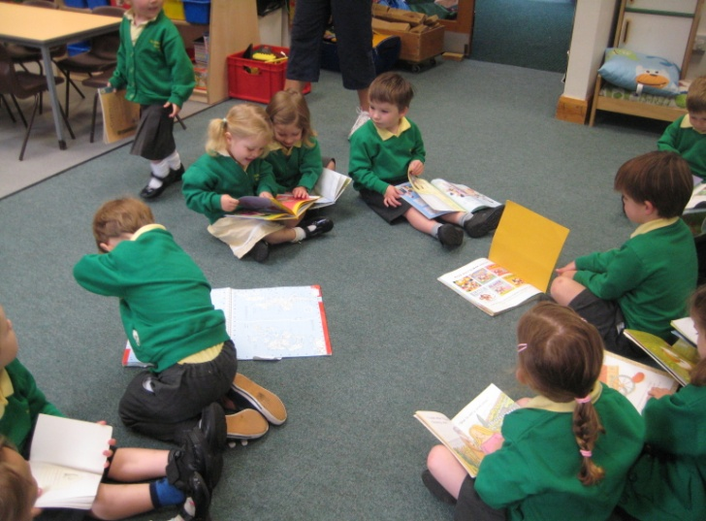
What do we learn?
3 prime areas
Personal, social and emotional development
Communication and Language
Physical development
4 specific areas
Literacy
Mathematical Development
Understanding the world
Expressive arts and design

Slide 13
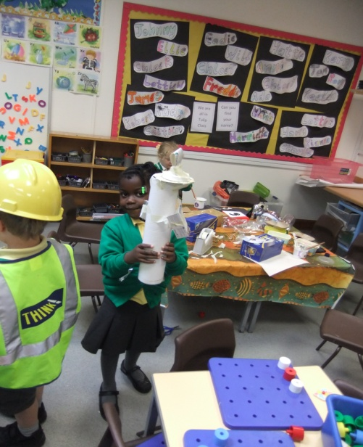
Who helps us learn?
It is important that everyone is part of the children’s learning journey
The child’s voice
The parents’ voice
The school’s voice

Slide 14
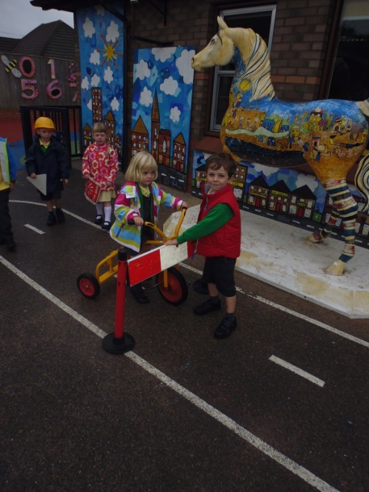
How do we look at learning?
Reception Baseline
Observation
Working with the children
Listening
Learning detectives
Questioning

Slide 15
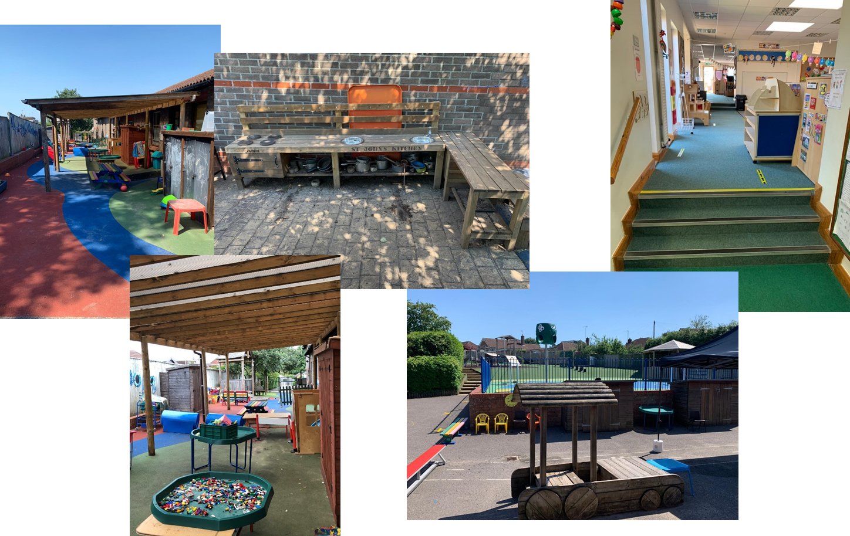
What does our Foundation Area look like?

Slide 16
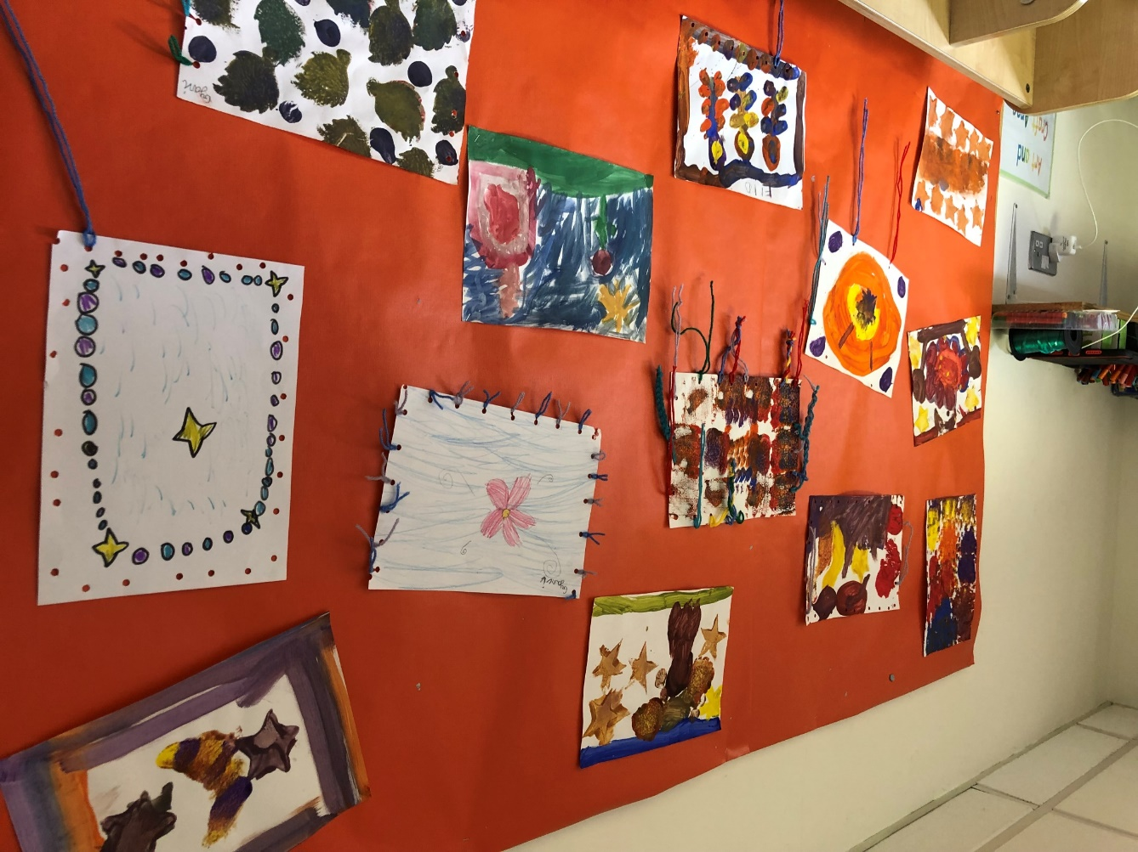
Starting Reception in September
Home visits
Part time sessions
Starting full time
Building relationships
Open door policy

Slide 17
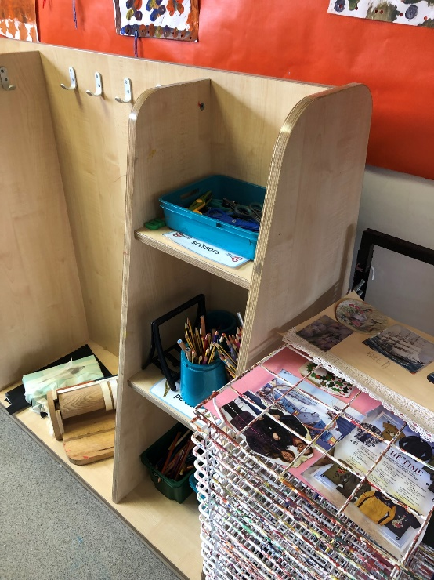
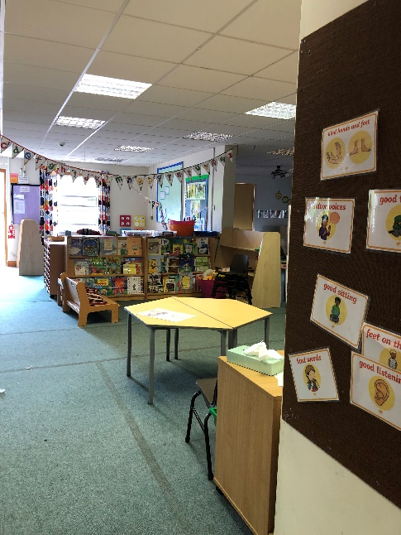
What happens in a typical day?
Play based curriculum – similar to current nursery/pre school
EYFS area where 60 reception and up to 26 nursery children work together during discovery time
Short sessions of direct teaching every day – maths/literacy/ other areas
Daily phonic sessions
PE
Lunchtime
Children’s ideas direct learning – follow own interests

Slide 18

Any questions?

