Slide 1
Phonics Screening Check 2023

Slide 2
What is the phonics screening check?
Check to allow teachers to assess children’s developing phonic knowledge to ensure that children are able to read words and that they are on track to become fluent readers who can enjoy reading for pleasure and learning
National assessment for all Year 1 children and Year 2 children who didn’t achieve the expected standard in Year 1
This year w/b 12th June
40 words to read – 20 real words and 20 pseudo/alien/nonsense words
Children work individually with teacher starting with practise words

Slide 3

Pseudo/Alien/Nonsense words
Included because they are new to all children and assess whether a child can decode using phonic skills and not their memory
Phonically decodable and have an alien picture to show not real words
During phonics lessons children regularly read nonsense words

Slide 4
What will it check?
Children can sound out and blend graphemes in order to read simple words
Read phonetically decodable one-syllable and 2 syllable words e.g. cat, sand, windmill
Read a selection of nonsense words

Slide 5
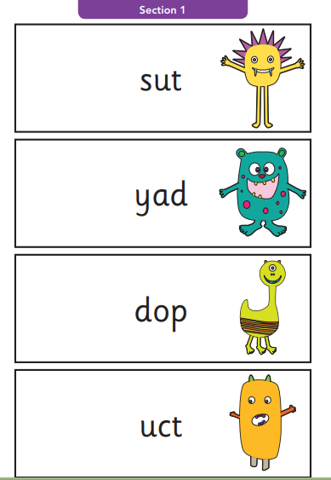
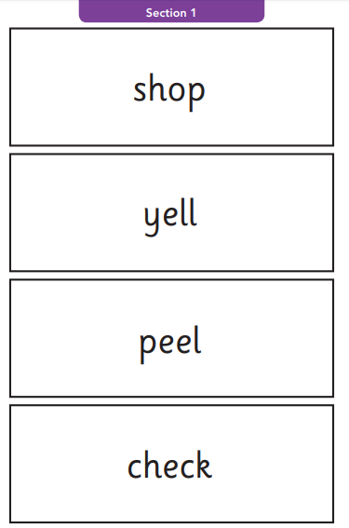
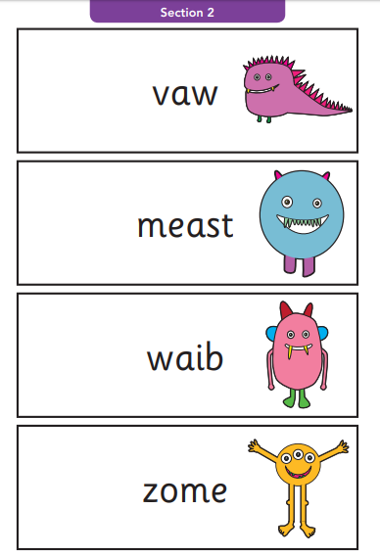
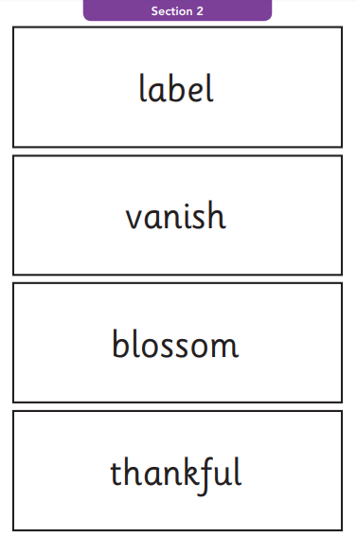
What will it look like to the children?
Section 1
Section 2
12 ‘nonsense’ words.
8 real words.
8 ‘nonsense’ words.
12 real words.
20 words
single letters (a, b, c, d, e, f, g, h, I, j, k, l, m, n, o, p, q(u), r, s, t, u, v, w, x, y, z)
some consonant digraphs (ch, ck, ff, ll, ng, sh, ss, th, zz)
frequent and consistent vowel digraphs (ar, ee, oi, oo,or)
20 words
additional consonant digraphs (ph, wh)
less frequent and consistent vowel digraphs, including split digraphs (a-e, ai, au, aw, ay, ea, e-e, er, ew, i-e, ie, ir, oa, o-e, ou, ow, oy, ue, u-e, ur)
trigraphs (air, igh).

Slide 6
How can you help at home?
At home you can continue to read as much as possible with your child. Ensure that your child is segmenting and blending unknown words when they are reading.
E.g. Shirt –
Segment it = Sh – ir – t
Blend it = Shirt.
It is important that you encourage your child to blend the word once they have segmented it as marks can’t be given if words are not fully blended in the check.

Slide 7
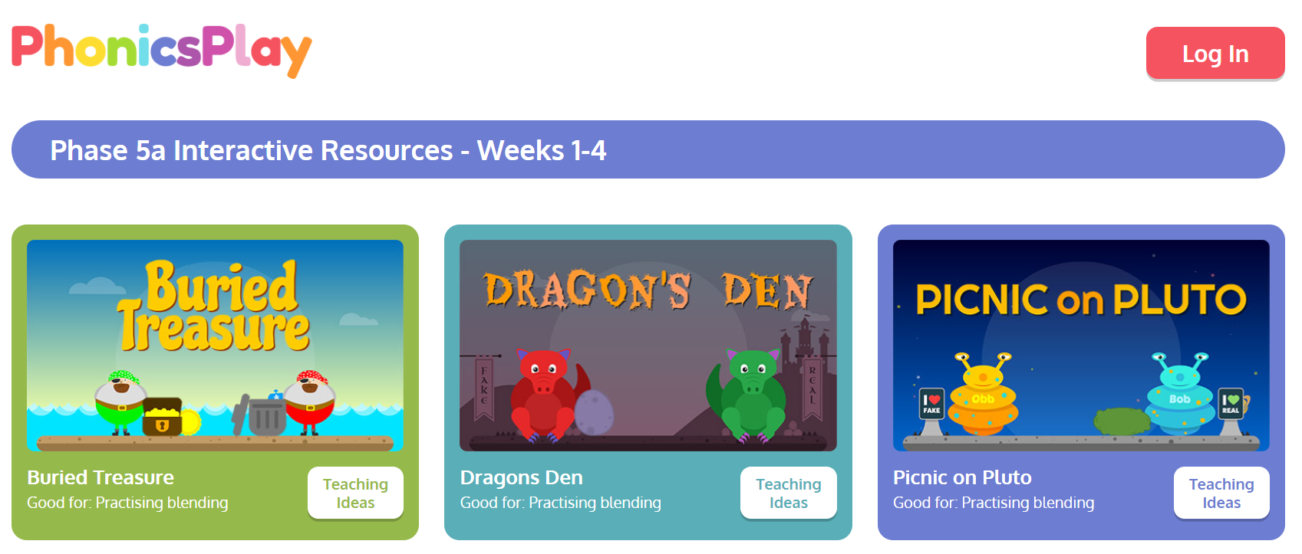
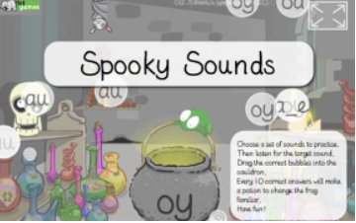
Games! Fun ways to practise phonics
Phonics Play
These are the games which you can play that do not require a subscription. We have played these games in class so the children are familiar with them!
https://www.phonicsplay.co.uk/resources/phase/5
Spooky Sounds
Children to identify digraphs and split digraphs from a range of other digraphs.
https://www.ictgames.com/mobilePage/spookySounds/index.html
You can find other Phonics games on Top Marks as well;
https://www.topmarks.co.uk/english-games/5-7-years/letters-and-sounds

Slide 8
Any questions?

