Slide 1
Parent Information Meeting
English and Maths Information for KS1 Parents

Slide 2
What are the national expectations?

Slide 3
English – Expectations – Year 1
Statutory Reading Expectations
Pupils should be taught to:
  apply phonic knowledge and skills as the route to decode words
  respond speedily with the correct sound to graphemes (letters or groups of letters) for all 40+ phonemes, including, where applicable, alternative sounds for graphemes
  read accurately by blending sounds in unfamiliar words containing GPCs that have been taught
  read common exception words, noting unusual correspondences between spelling and sound and where these occur in the word
  read words containing taught GPCs and –s, –es, –ing, –ed, –er and –est endings
  read other words of more than one syllable that contain taught GPCs
  read words with contractions [for example, I’m, I’ll, we’ll], and understand that the apostrophe represents the omitted letter(s)
  read aloud accurately books that are consistent with their developing phonic knowledge and that do not require them to use other strategies to work out words
  re-read these books to build up their fluency and confidence in word reading.

Slide 4
English Expectations – Year 1 Reading Comprehension
develop pleasure in reading, motivation to read, vocabulary and understanding by:
listening to and discussing a wide range of poems, stories and non-fiction at a level beyond that at which they can read independently
being encouraged to link what they read or hear read to their own experiences
becoming very familiar with key stories, fairy stories and traditional tales, retelling them and considering their particular characteristics
recognising and joining in with predictable phrases
learning to appreciate rhymes and poems, and to recite some by heart ▪ discussing word meanings, linking new meanings to those already known
understand both the books they can already read accurately and fluently and those they listen to by:
drawing on what they already know or on background information and vocabulary provided by the teacher
checking that the text makes sense to them as they read and correcting inaccurate reading
discussing the significance of the title and events ▪ making inferences on the basis of what is being said and done
predicting what might happen on the basis of what has been read so far
participate in discussion about what is read to them, taking turns and listening to what others say
explain clearly their understanding of what is read to them.

Slide 5
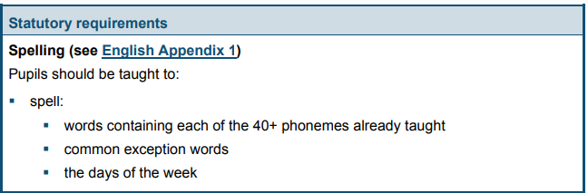
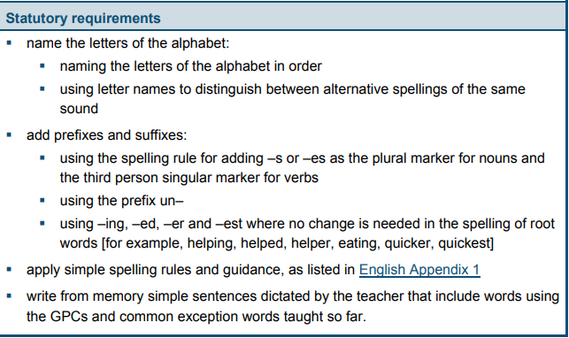
English Expectations – Year 1 Writing

Slide 6
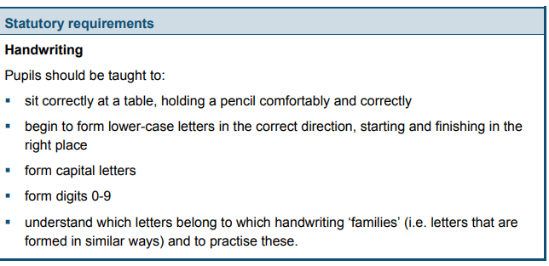
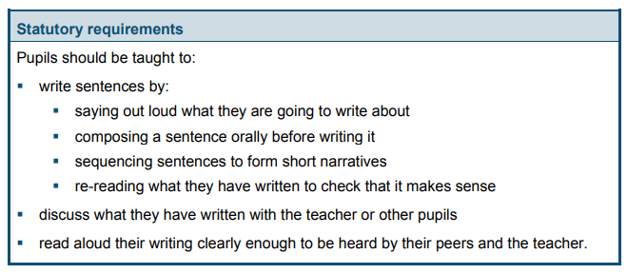
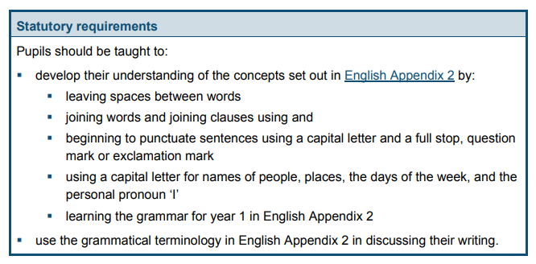

Slide 7
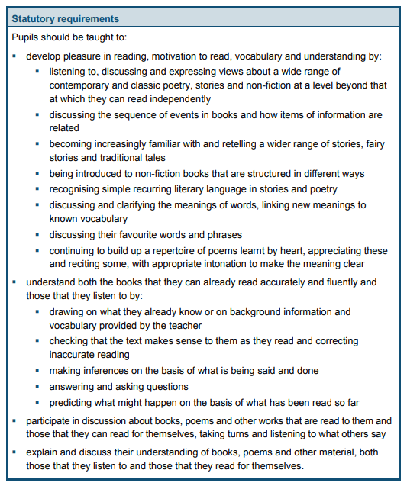
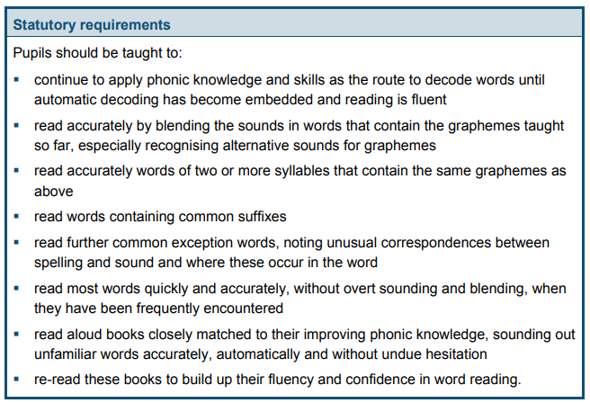
Year 2 Expectations - Reading

Slide 8
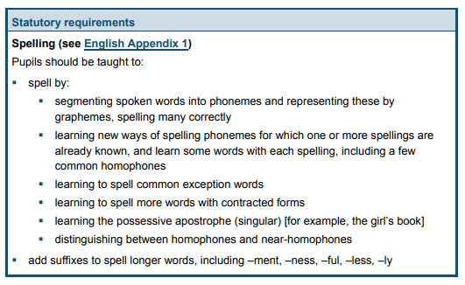
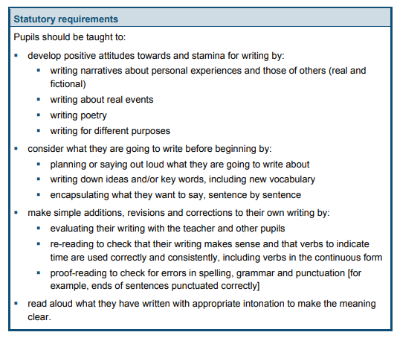
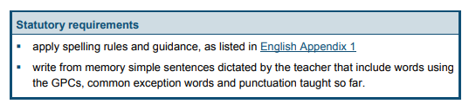

Slide 9
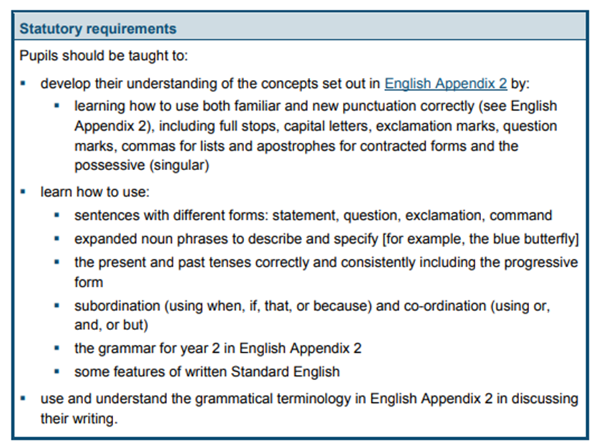

Slide 10
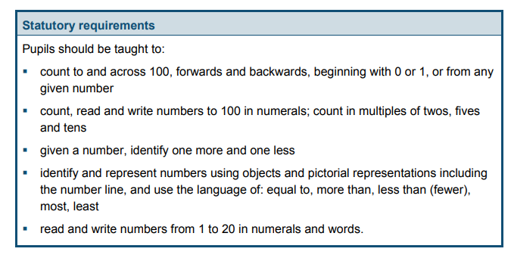
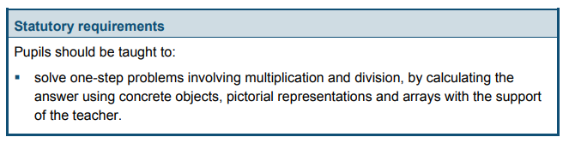
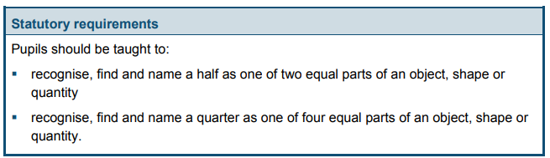
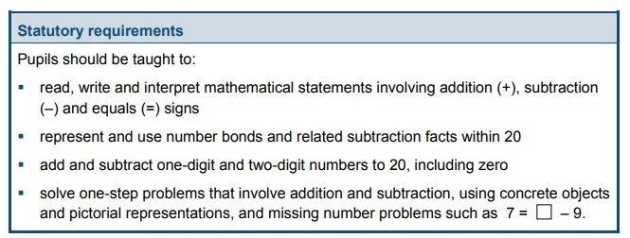
Maths – Year 1

Slide 11
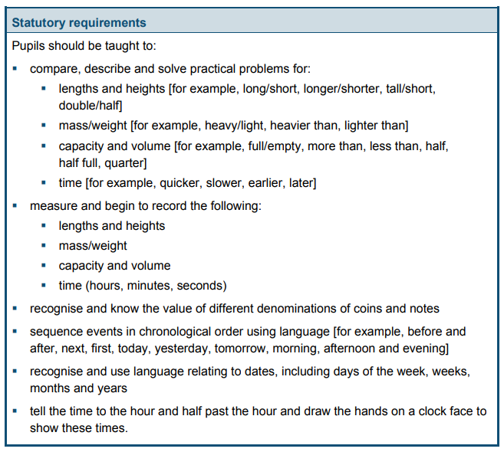
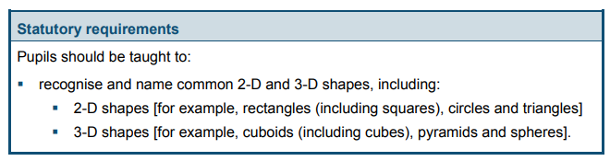
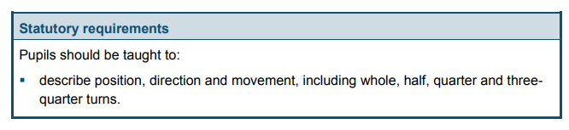

Slide 12
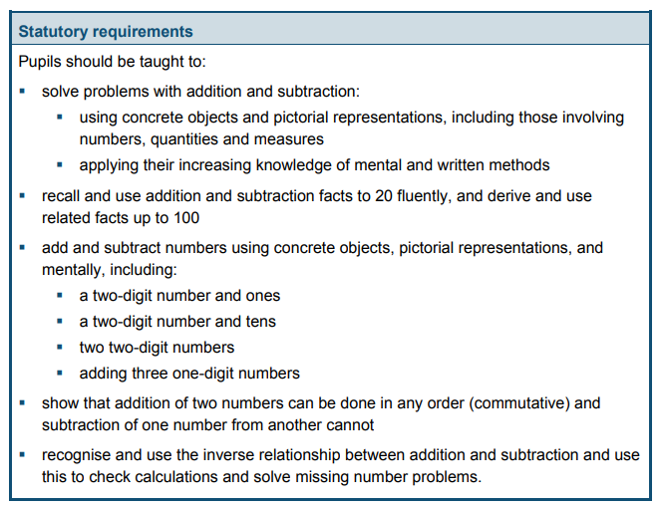
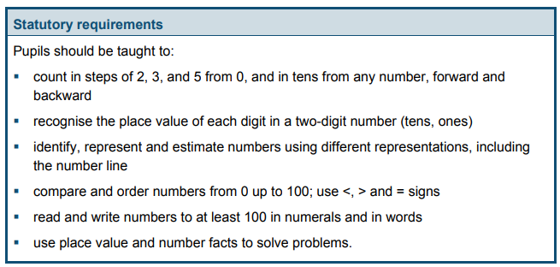
Year 2

Slide 13
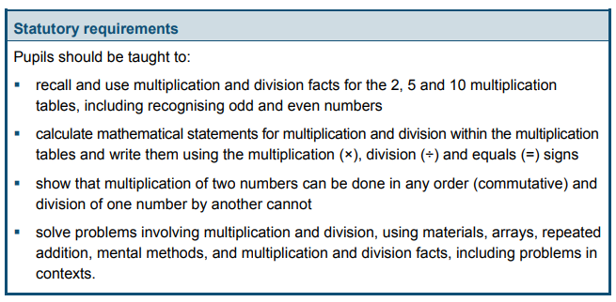
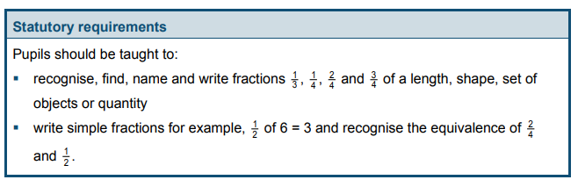

Slide 14
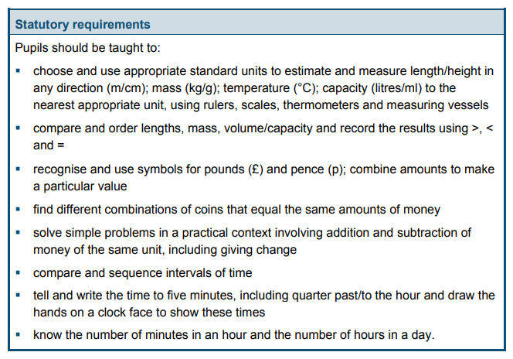
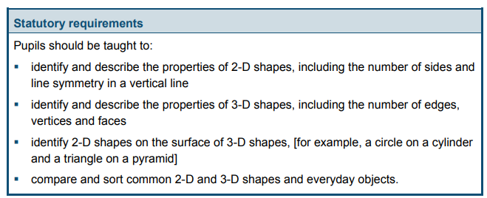

Slide 15
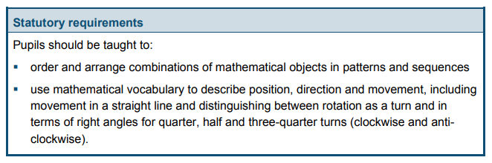
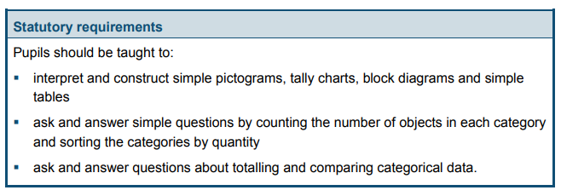

Slide 16
How do we teach this in school?
Phonics and Reading
Taught largely whole class all children learning same phoneme.
Learning to read and write letters develops phonemic awareness rapidly
Consolidating previous learning, learning new content, practising and applying what they have learnt
Taught phonic phrases to support phoneme and also letter formation cues
Multi sensory approach – songs, actions, writing words, reading
Opportunities to write during phonics and reading session
Weekly reading book supports the phonics lesson focus and also allows skills of comprehension, expression and vocabulary extension

Slide 17
A typical phonics session
Read GPCs
Children read GPCs learnt so far as you point to them rapidly /ea/ /oy/ /ir/ /ue/ /aw/ /ew/
Stretch and Read
Write the word ‘chew’ on the board and ask the children to read it aloud. If necessary, guide the children in how to fast blend the sounds to read the word.
Repeat with the following words: crawls, rescue, whistle, August, obey*
Introduce the Common Exception Word: ‘beautiful’ and model how to decode the phonically regular parts of the word (‘b’, ‘tif’, ‘l’) and identify the ‘tricky’ graphemes (‘eau’,‘u’). Then use Say-Spell-Say to spell the entire word.
Repeat for ‘plant’** (plant).
Partners turn to Step 45 Day 1 in Partner Practice Booklet 5 and take turns reading the words and sentence in the green boxes.

Slide 18
Quick Erase
Write the word ‘dew’ on a whiteboard and ask the children to read it.
Quickly erase ‘d’ and replace it with ‘f’ so the word now reads ‘few’. Ask the children to read the new word.
Repeat with the following words: flew, flaw, law, lie, lies,flies.
Teaching point: explain that ‘ey’ is another way of spelling the /ai/ sound.
Present New GPC
Introduce the Picture Sound Card for the new GPC and say the mnemonic phrase: ‘Bake a cake.’
Ask children to identify the common sound they hear in the words.
Explain that a_e is a split vowel digraph.
Use a whiteboard or flipchart to write the word ‘cake’ and demonstrate how a_e makes the /ay/ phoneme despite being separated or split by ‘k’.
• Explain that a split digraph is a digraph (two letters thatmake one sound) that is split by a consonant. Usually a long vowel sound, e.g. ‘a-e’ (cake), ‘i-e’ (five), ‘o-e’ (code), ‘e-e’(complete) and ‘u-e’ (rule).
Write the word ‘cak’ on the whiteboard or flipchart and demonstrate how without the final ‘e’ the word would be pronounced differently.

Slide 19
Other activities
Spelling Practice
Draw a line down the centre of the board to make four columns. Label the columns with the graphemes they know about for representing this phoneme (ai, ay, a_e, ey)
Read the word ‘they’ and encourage children to guide you as to which column to record it in.
Repeat for ‘train’, ‘cake’, ‘paper’, ‘stay’, ‘plate’.
Write Words and Sentences
Children then write the following words with familiar GPCs: straw, skewer, stature. And words containing the new GPC: late, amaze, chased, braver.
After each, write the correct spelling on the board for children to check their work.

Slide 20
Shared Reading
https://parents.fft.org.uk/tips-for-home-reading/
The Turning of the Year
Preview
What do you think ‘turning of the year’ means?
On which date does this happen?
In which season is this?
Predict
What do you think will happen at the ‘turning of the year’ in this story?

Slide 21
Look for examples of split digraph words where the final ‘e’ is dropped to add a suffix, e.g. ‘snoring’ and ‘flaming’.
Explain that usually when a word with a split vowel spelling has a suffix added, we drop the final ‘e’ before adding the suffix.
Summarise
What were the main things that happened in the story?
What is the season? How can we tell?
Writing time
Use the Writing Time process to model the following sentence that uses the word ‘because’ to join two clauses:
I like walking in the woods because it is quiet and still there.
Children compose their own sentences orally about why they do or do not like walking in the woods before telling their partner and writing them down individually.

Slide 22
Individual Reading
All children reading same book in school each week which will be shared with parents on weekly update to allow support at home
Children will also have individual reading books matched to their reading level, to further extend and develop skills and a love of reading
Individual reading books changed regularly
Children will be heard read individually less often but they will all read daily as part of reading session

Slide 23
Mastering Number
A bit like learning the alphabet and phonics – being able to use is key
Being able to understand what the digits mean and to manipulate and solve problems
Subitising – recognising pattern without counting
Really important to have quick recall, reasonableness of answers etc
Talk about understanding, number bonds
Whole part model

Slide 24
Mastering Number
Pupils will continue to explore the composition of numbers within 10 and explore addition and subtraction structures and the related language (without the use of symbols).
explore the composition of each of the numbers 7 and 9
explore the composition of odd and even numbers, seeing that even numbers can be made of two odd or two even parts, and that odd numbers can be composed of one odd part and one even part
identify the number that is two more or two less than a given odd or even number, identifying that two more/ less than an odd number is the next/ previous odd number, and two more/ less than an even number is the next

Slide 25


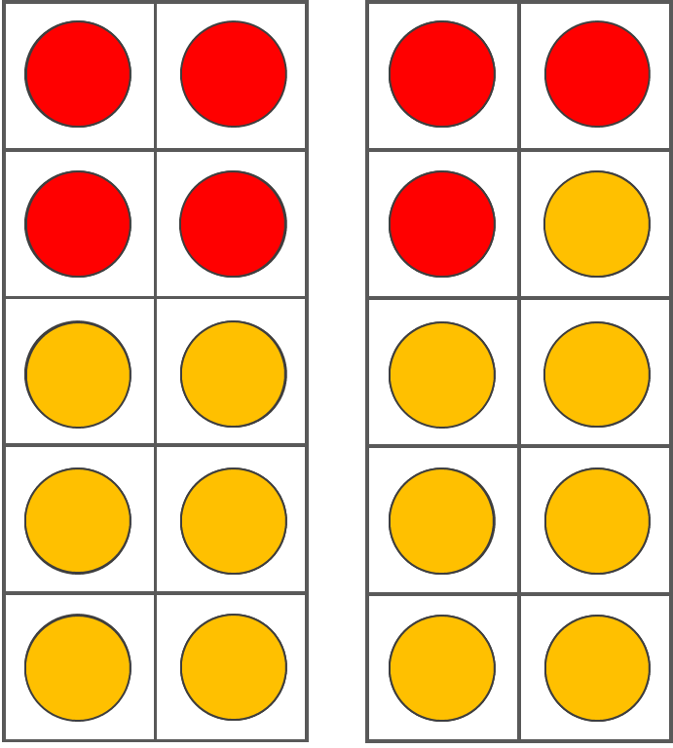
Let’s do some maths!
Year 1 – Structure of even numbers
Even numbers can be made of 2 odd parts or 2 even parts.
Even numbers can be made of 2s.
Even numbers can be made with doubles.
Notes:
Note that the structures above are all of those explored in Mastering Number for even numbers.
Provide participants with time to connect the structures with the concepts being illustrated, and then sequence them according to how they view Year 1 progression in the teaching of them over time.
Afterwards, note the following progression in line with programme materials in Year 1:
Week 6 explores doubles - so will help children with double and half facts.
Week 7 explores how even numbers are made of 2 - so will help children understand that adding and subtracting 2 to or from an even numbers will give the next or previous even number.
Week 14 looks at how even numbers can be made of 2 odd numbers or 2 even numbers - so will help them reason about both addition and subtraction facts.
25

Slide 26
Children in action

Slide 27
How can parents help at home?
Practise phonic skills - FFT books
Listen to your child read – 10 minutes a day – ask them questions about the book
Read to your child – quality books that they enjoy
Encourage writing for pleasure
Fun maths – count forwards and backwards, what is one more/less or ten more/less than this number
Year 2 – practise multiplication tables – 2X, 5X, 10X
Buy a watch and help your child to understand the concept of time

Slide 28
What is not helpful?
Avoid moving beyond Year 1 or Year 2 expectations
Better to work in more depth than to move on – this develops understanding
Avoid American resources – this can lead to confused speech/spelling etc.
Make sure you distinguish between upper and lower case letters in the right situations
Encourage punctuation – help children to see how punctuation is used in books that you read

