Slide 1
Osmington Bay 2026
Final Meeting

Slide 2
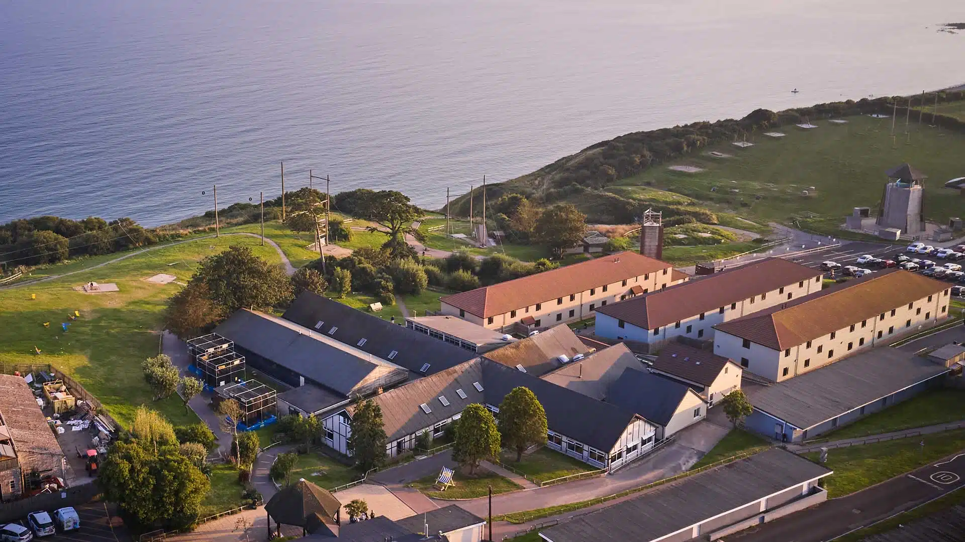

Slide 3
Osmington Bay
Near Weymouth in Dorset
Residential visit offering opportunities for leadership and team work in a stunning environment.
Full of exciting outdoor and adventurous activities.
PGL centre – provides reassurance on health and safety and care

Slide 4
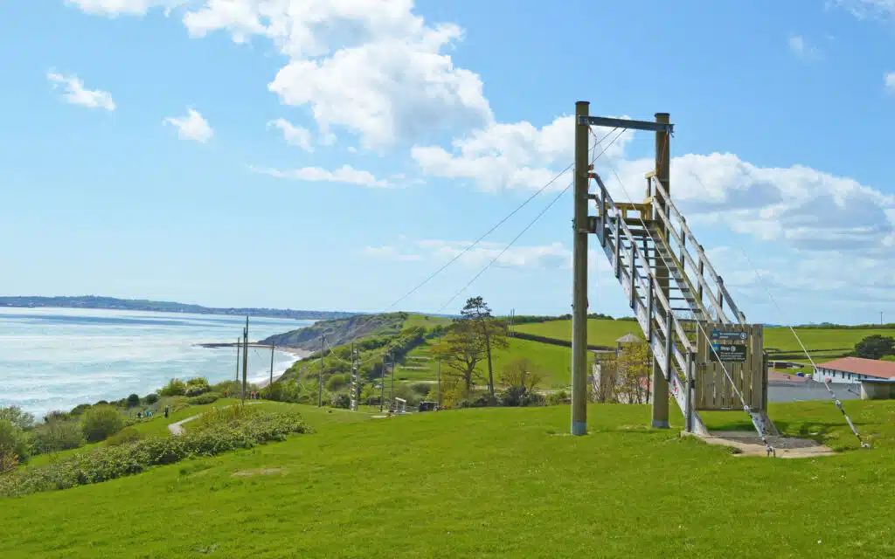

Slide 5
Dates and times
Sunday 14th June
11am: Arrive at school
11.30am: Coach leaves school
3.00 (approx): Arrive at Osmington Bay
Wednesday 17th June
2pm: Coach leaves Osmington Bay
5.00pm (approx): Coach returns to St Nic’s

Slide 6
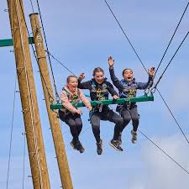

Slide 7
Where do children sleep?
Bowleaze Cove accommodation
Dormitory accommodation – 4 children per room
Bunk beds
Ensuite
Drying rooms
Centrally heated

Slide 8
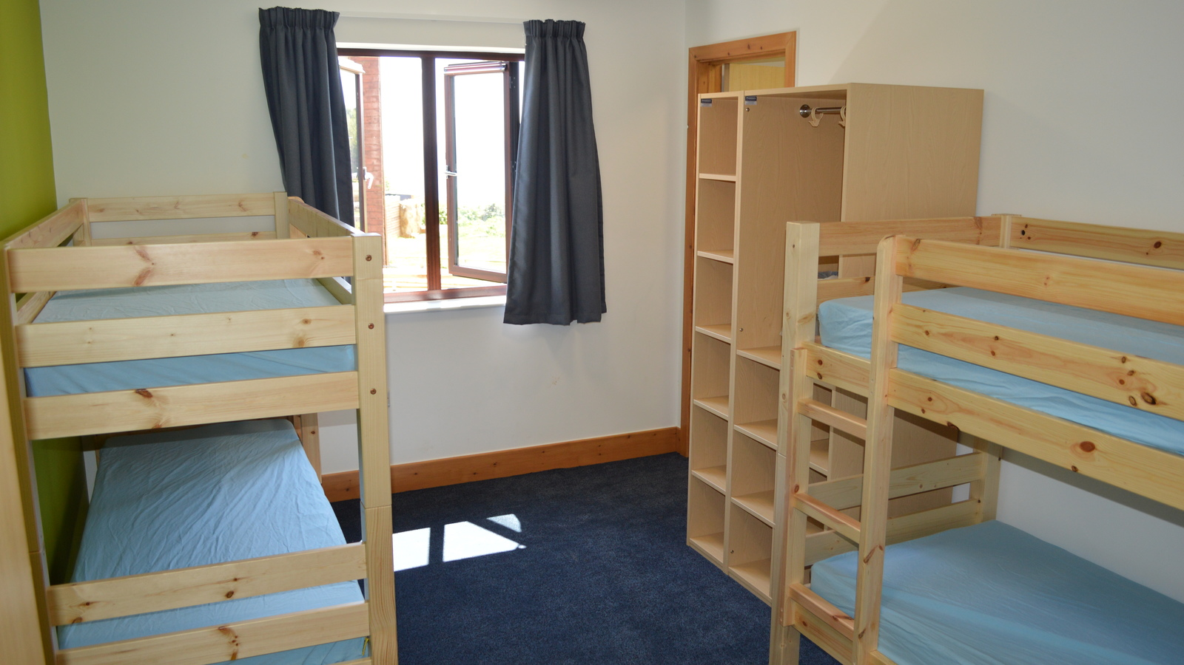

Slide 9
What does a typical day look like?
7am Wake up and get ready
8am Breakfast
9.00 Morning activities
12.30 Lunch
2.15 Afternoon activities
5.30 Evening Meal
7.30 Evening activities
9.30ish Lights out and sleep

Slide 10
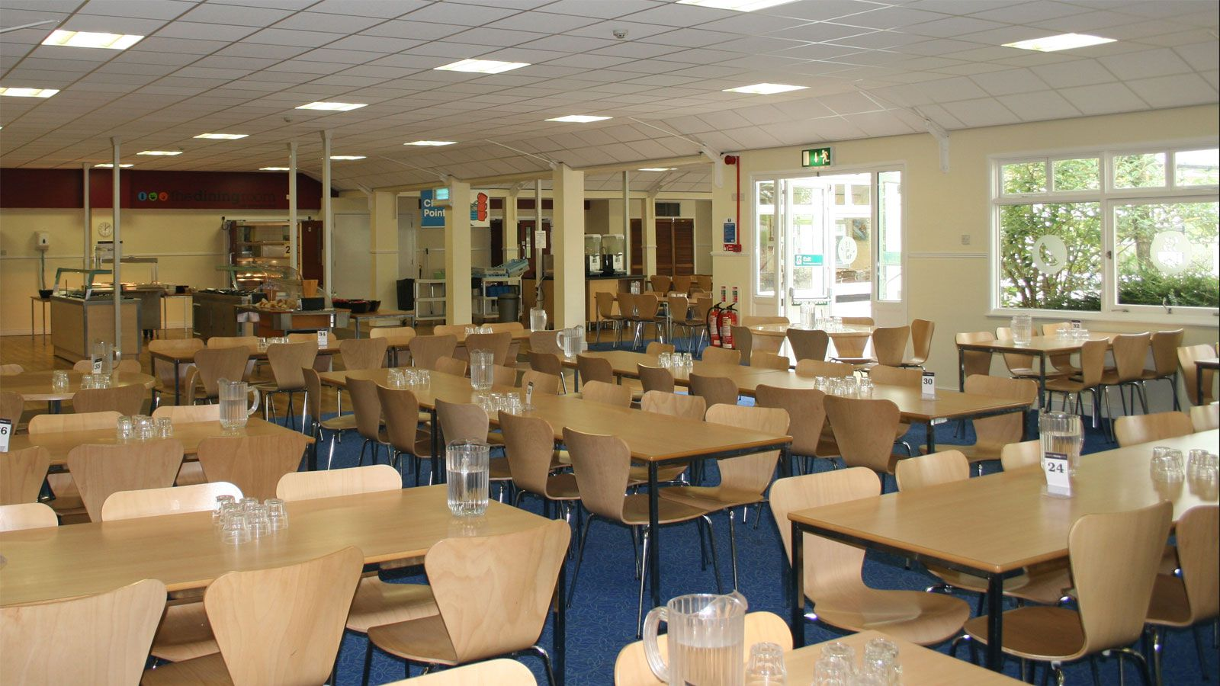

Slide 11
Activities
Day 1: Travel plus Evening activity
Day 2 and 3: Morning and afternoon activities plus evening activity
Day 4: Morning activities and home

Slide 12
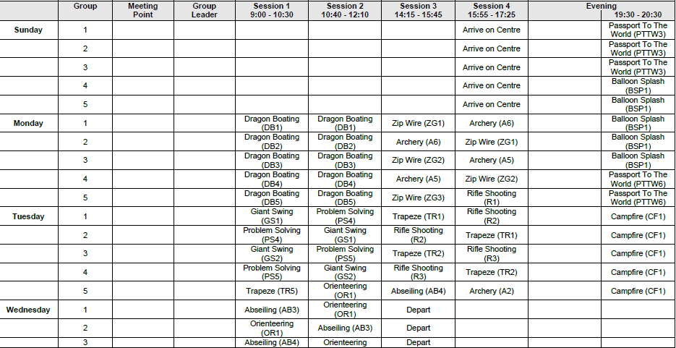

Slide 13
What activities do we do?
Dragon Boating
Abseiling
Zip line
Archery
Giant Swing
Trapeze
Rifle Shooting
Orienteering
Problem Solving
Passport to the World
Campfire
Disco

Slide 14


Slide 15
Dos and Don’ts
No electronic devices – tablets, phones etc. not allowed
No smart watches or air tags
Camera can be brought – but either disposable or digital camera – not on a phone or communication device
Books and Kindles are allowed but only for reading (not Kindle Fire)
A small teddy or comforter is allowed – however, we ask that you do not pack night lights or similar as these can affect the sleep of others

Slide 16
Money and Shop
There is a small shop on site
We would ask that children bring up to £15 to spend
We will restrict children on the number of sweets they can buy

Slide 17
Groups
There will be five activity groups
All activities will take place in those groups
No obligation to take part in an activity, but all children are encouraged
Some activities – more than one group together

Slide 18
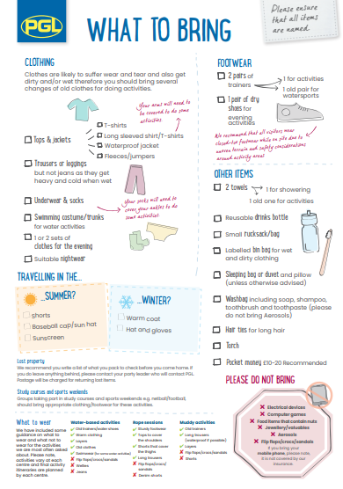

Slide 19
Food
High quality food provided on site
Packed lunches provided for off-site activity days and for final day
Cooked meals for breakfast, lunch and dinner
Several options
Cater for various diets – need to know in advance

Slide 20


Slide 21
School Staff
Mr Harvey
Mrs Davies
Mrs Gillman
Mrs Hill
Mr Hill

Slide 22
What now?
Final letter, medical form, kit list and activity programme will be sent out tomorrow
Please return medical form as soon as possible – latest by Friday 1st May.
I will be speaking to children about friendship groups for rooms and groups

