Slide 1
Year 5 Residential 2027
Grittleton House

Slide 2
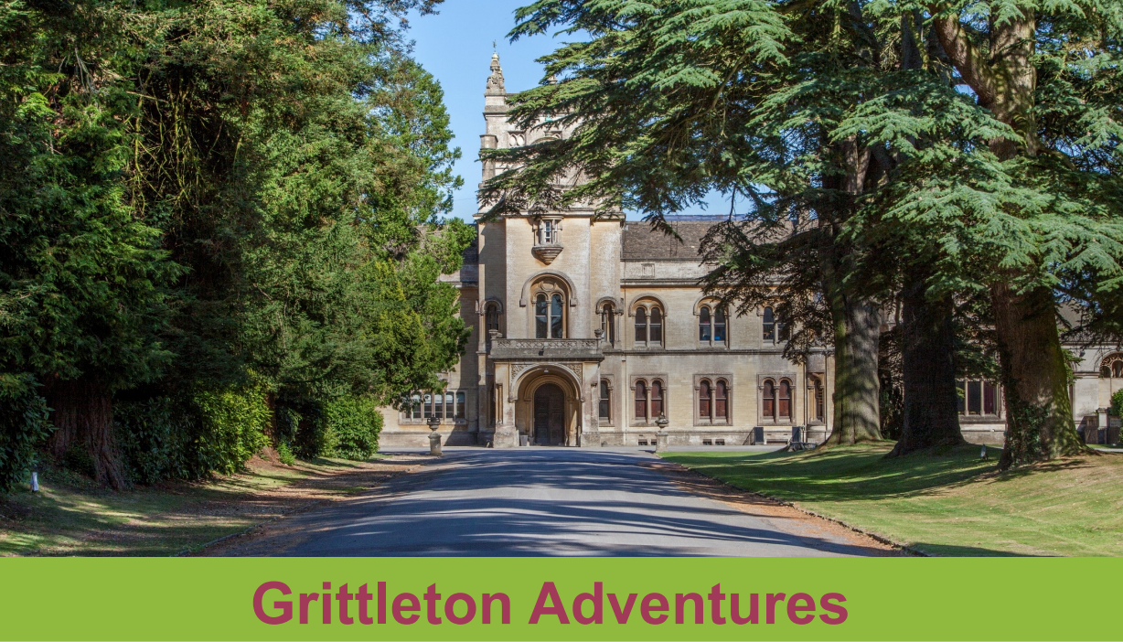
Grittleton House

Slide 3
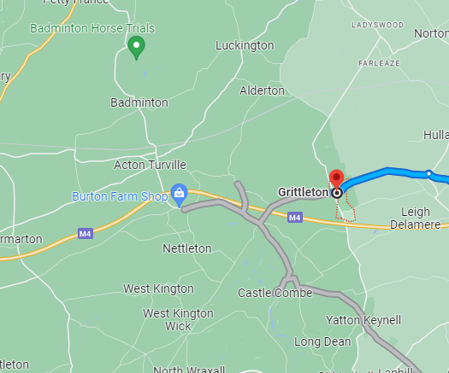
Where are we going?
Grittleton Adventures are situated at Grittleton House in the beautiful Wiltshire village of Grittleton on the edge of the Cotswolds.
They are a family run business with over 70 years’ experience providing residential trips for schools providing a full and varied range of instructor led activities

Slide 4
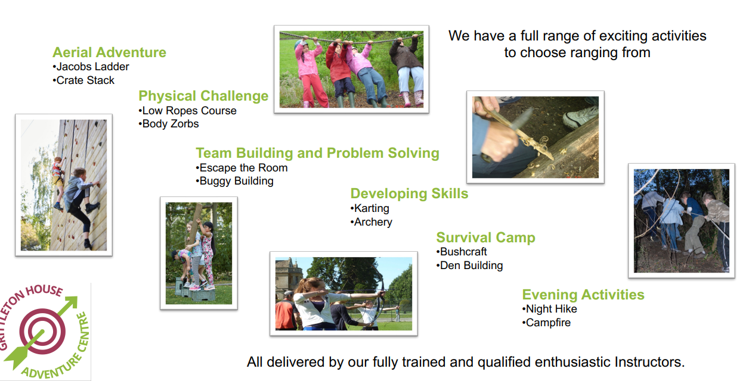
What will we do?

Slide 5
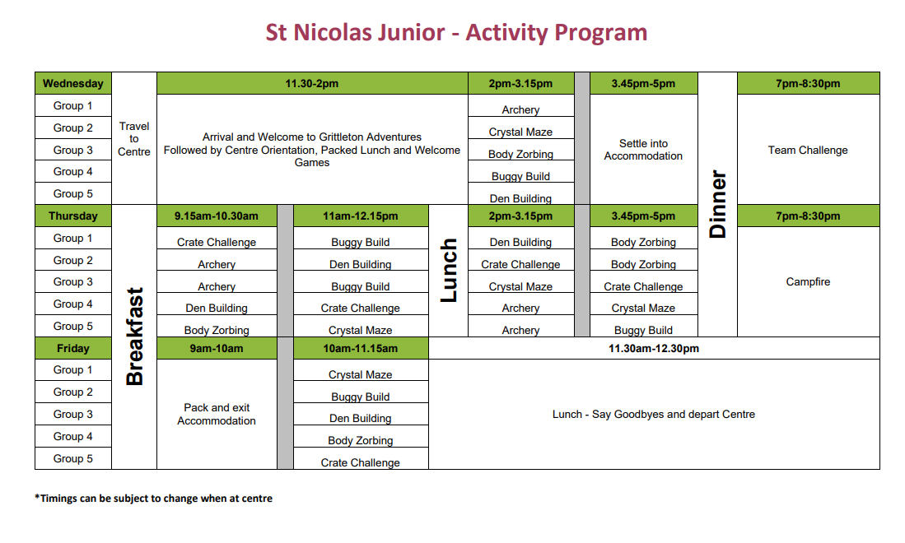
Example activity plan

Slide 6
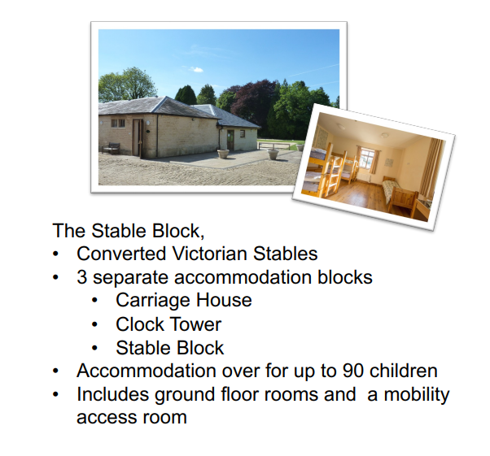
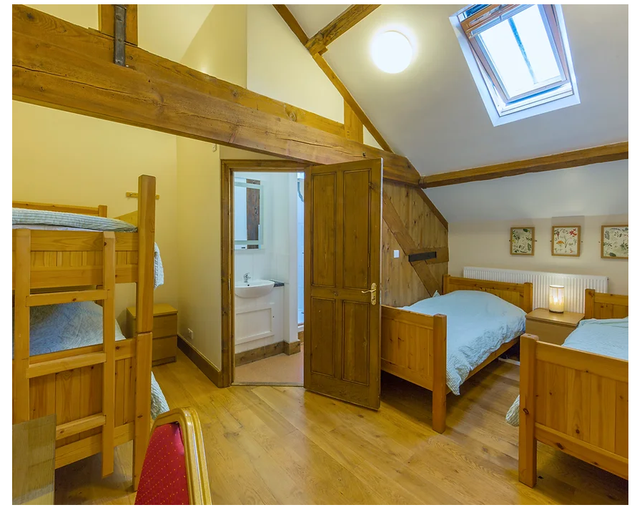
Accommodation

Slide 7
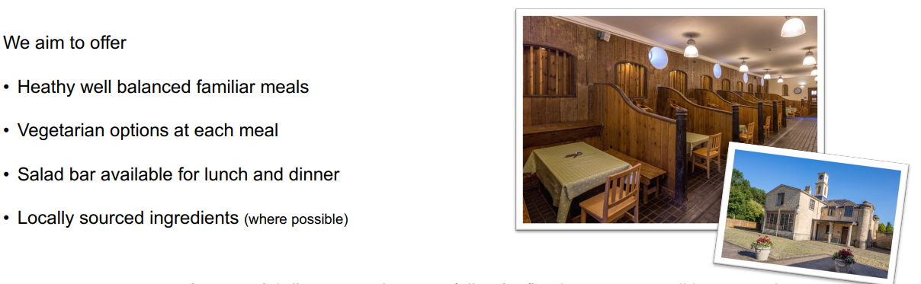
Meals

Slide 8
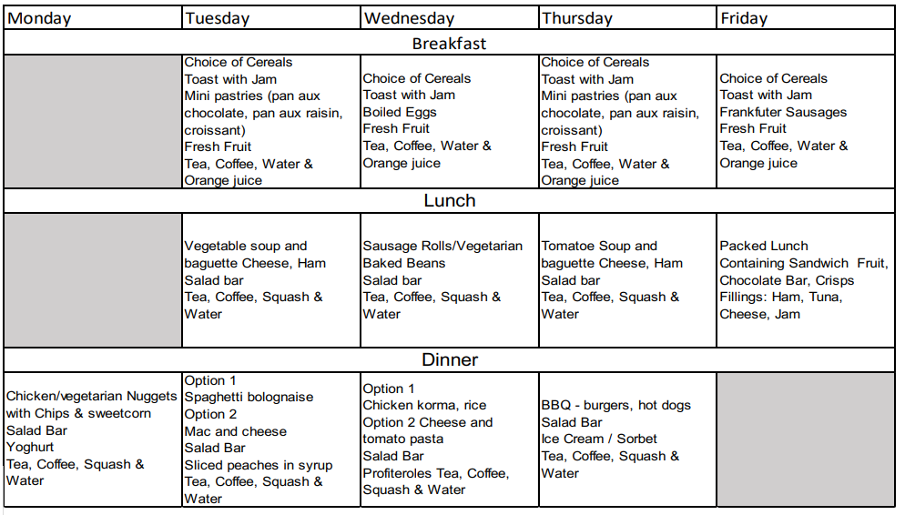
Sample Menu

Slide 9
Health and Safety
Risk Assessments in place for all activities
Duty Manager on site throughout the day and 24 hour on call access
Trained instructors for all activities
Fire procedures and drills
First Aiders onsite
Accommodation buildings locked with key code locks
St Nics trained staff with all groups

Slide 10
Key Information
Leaving on Wednesday 21st April
Returning on Friday 23rd April
We will be taking adults from school
The activities will all be led by instructors
Full itinerary will be available closer to the time
Kit list will be provided

Slide 11
Costs
The total cost for the trip will be approximately £285
We now need to reserve places for the trip and would ask that you pay a non-refundable deposit of £45 on ParentPay by 10th July 2026,
Below is the expected payment schedule:
10/07/2026 £45 Non refundable
30/09/2026 £40 Non refundable
31/10/2026 £40
30/11/2026 £40
31/12/2026 £40
31/01/2027 £40
28/02/2027 £40 *To be confirmed and adjusted with final cost
All payments should be made via ParentPay.

Slide 12
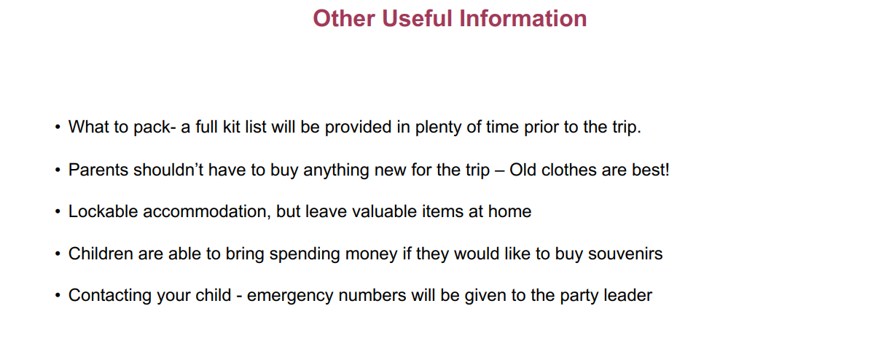

Slide 13
Next Steps
Deposit letter will be sent out tomorrow to all parents
Payment details will be added to ParentPay
Next year further information will be sent to parents
If there are any questions or queries then please come and see me or email me at:
lthorntonallen@stnics.w-berks.sch.uk

