Slide 2

Disclaimer: Our resource creation team do their best to provide phonically regular ‘nonsense’ words that are not in use as colloquial or slang language. We recommend that any student research into real and ‘nonsense’ words is done with a reliable dictionary. Twinkl cannot be held responsible for slang definitions discovered when searching the internet and any liability associated with this.

Slide 3




twirl

Slide 4
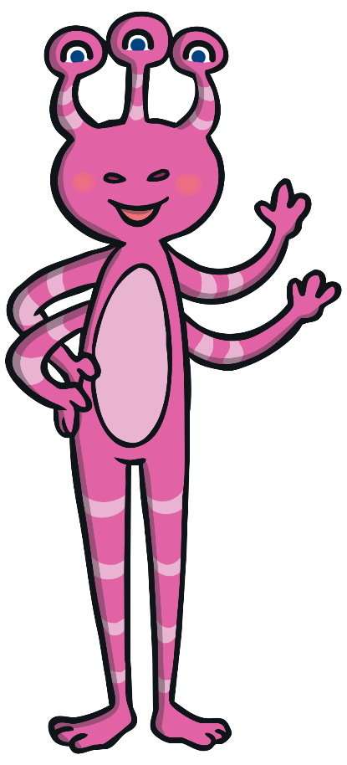
rird

Slide 5
thirteen

Slide 6
shirt

Slide 7
straun

Slide 8
fir

Slide 9
bird

Slide 10

trow

Slide 11
birth

Slide 12

whape

Slide 13
fuel

Slide 14
glued

Slide 15
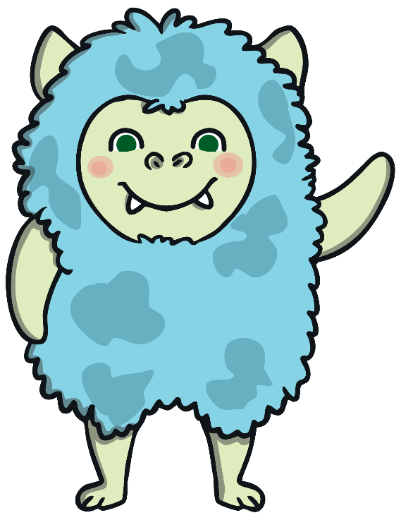
whime

Slide 16

slirt

Slide 17
true

Slide 18
cue

Slide 19
due

Slide 20
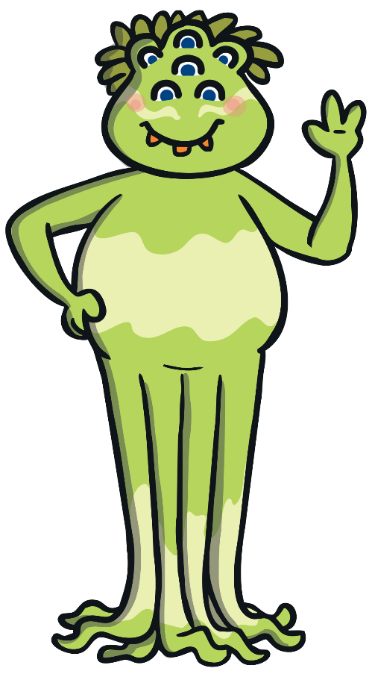
wheme

Slide 21

whibe

Slide 22
venue

Slide 23
blue

Slide 24
rescue

Slide 25
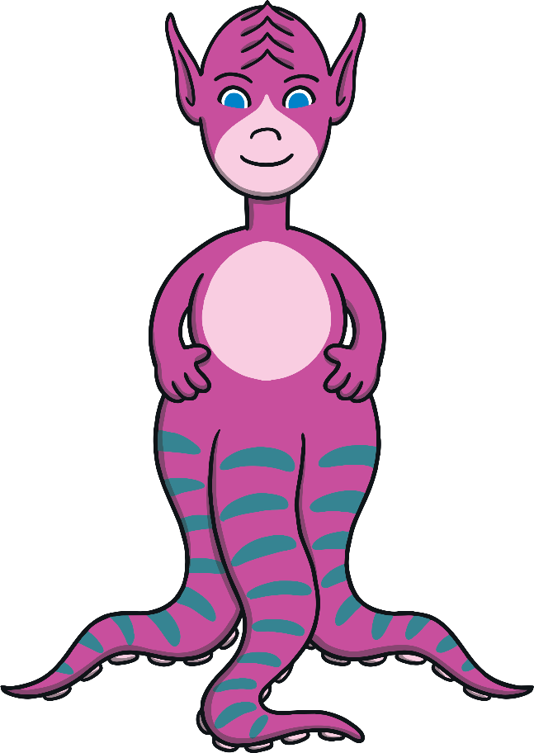
fice

Slide 26
new

Slide 27

zued

Slide 28
pew

Slide 29
splue

Slide 30
stew

Slide 31

plues

Slide 32
few

Slide 33
pewt

Slide 34
straw

Slide 35
splaw

Slide 36
saucers

Slide 37
phent

Slide 38
law

Slide 39
haunt

Slide 40
traum

Slide 41
girl

Slide 42
zow

Slide 43
draw

Slide 44
whid

Slide 45
yawn

Slide 46
blaut

Slide 47
August

Slide 48
flaunt

Slide 49

maush

Slide 50
arrow

Slide 51
window

Slide 52
gelp

Slide 53
own

Slide 54

plaw

Slide 55
throw

Slide 56
whope

Slide 57
wheel

Slide 58

phabe

Slide 59
which

Slide 60
yeath

Slide 61
whim

Slide 62
frue

Slide 63
whisper

Slide 64
vead

Slide 65
whine

Slide 66
whiskers

Slide 67
rice

Slide 68
pread

Slide 69
slice

Slide 70
vaw

Slide 71
cell

Slide 72
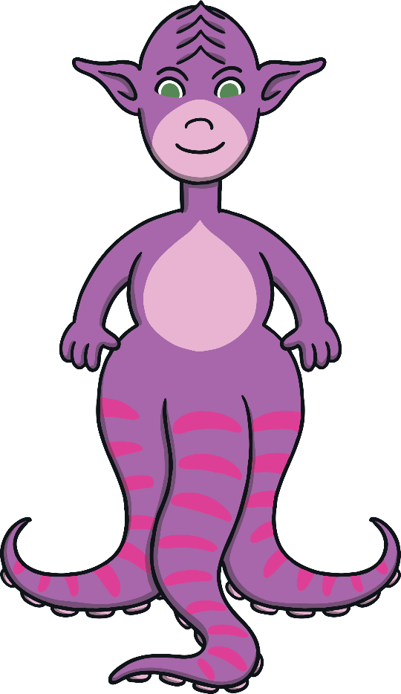
whib

Slide 73
acid

Slide 74
gent

Slide 75
jice

Slide 76
gem

Slide 77
ginger

Slide 78

phap

Slide 79
lorph

Slide 80
magic

Slide 81
phupe

Slide 82
phonics

Slide 83
sphinx

Slide 84
dolphin

Slide 85
chead

Slide 86
phantom

Slide 87
head

Slide 88
vield

Slide 89
bread

Slide 90
crief

Slide 91
read

Slide 92

thirl

Slide 93
instead

Slide 94
dead

Slide 95
shirm

Slide 96
feather

Slide 97
snue

Slide 98
deaf

Slide 99
chief

Slide 100
plice

Slide 101
brief

Slide 102
geal

Slide 103
field

Slide 104
balph

Slide 105
glead

Slide 106
shield

Slide 107
priest

Slide 108
gead

Slide 109
shriek

Slide 110
thief

Slide 111
birm

Slide 112
match

Slide 113
witch

Slide 114
clirt

Slide 115
ditch

Slide 116
crutch

Slide 117
girst

Slide 118
thirn

Slide 119
relief

Slide 120
craw

Slide 121
patch

Slide 122
gice

Slide 123
third

Slide 124
stitch

Slide 125
gead

Slide 126
scrief

Slide 127
while

Slide 128
griest

Slide 129
fotch

Slide 130
getch

Slide 131
petch

Slide 132
scretch

Slide 133
catch

Slide 134
bretch

Slide 135
breakfast

Slide 136
spletch

