Slide 2





spoilt

Slide 3
bench

Slide 4

frex

Slide 5

scrug

Slide 6

plarsh

Slide 7
brown

Slide 8

thrand

Slide 9
brush

Slide 10

frist

Slide 11
champ

Slide 12
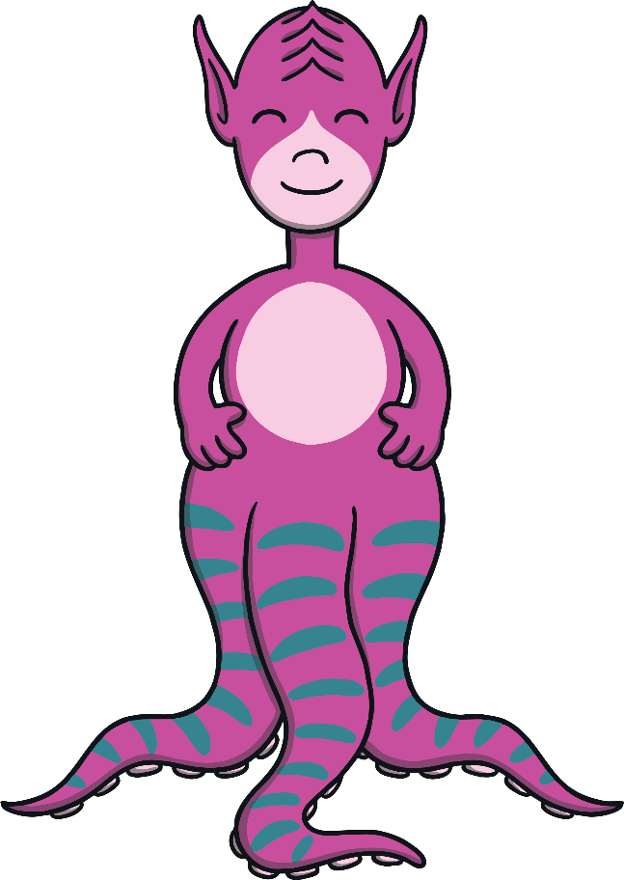
harnd

Slide 13

flept

Slide 14
chimp

Slide 15
clap

Slide 16
braft

Slide 17
cloaks

Slide 18
crab

Slide 19

chilt

Slide 20
crept

Slide 21
blosh

Slide 22
crisp

Slide 23
chest

Slide 24
floost

Slide 25
drop

Slide 26
dust

Slide 27
flat

Slide 28

eps

Slide 29
floating

Slide 30
criff

Slide 31
forest

Slide 32
cloin

Slide 33
fresh

Slide 34
boost

Slide 35
ept

Slide 36
fund

Slide 37
gift

Slide 38
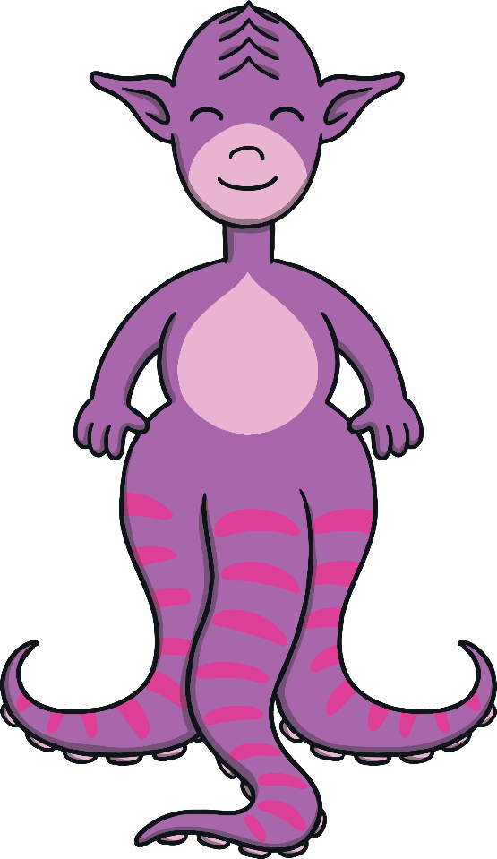
glisp

Slide 39
glomp

Slide 40
trunk

Slide 41
gloom

Slide 42
grab

Slide 43
glips

Slide 44
greet

Slide 45
meft

Slide 46
groan

Slide 47
groans

Slide 48
melp

Slide 49
helping

Slide 50
grench

Slide 51
helper

Slide 52
joint

Slide 53
plap

Slide 54
moist

Slide 55
frex

Slide 56
keeps

Slide 57

skalf

Slide 58
lords

Slide 59

scrid

Slide 60
melting

Slide 61
milk

Slide 62
sarps

Slide 63
paint

Slide 64
froin

Slide 65
parks

Slide 66
fler

Slide 67
brighter

Slide 68
bluns

Slide 69
portrait

Slide 70
press

Slide 71
scurb

Slide 72
printer

Slide 73
props

Slide 74
pumpkin

Slide 75
floost

Slide 76
roast

Slide 77
haps

Slide 78
sand

Slide 79
froin

Slide 80
murbs

Slide 81
scram

Slide 82
prulk

Slide 83
screen

Slide 84
gelt

Slide 85
scalp

Slide 86
shrip

Slide 87
scrunch

Slide 88

sprop

Slide 89
second

Slide 90
ulb

Slide 91
shelf

Slide 92
gelt

Slide 93
shelter

Slide 94
shift

Slide 95
frem

Slide 96
shrink

Slide 97
herks

Slide 98
shrubs

Slide 99
melp

Slide 100
shuts

Slide 101
sixth

Slide 102
jelp

Slide 103
skill

Slide 104
smart

Slide 105
scrolk

Slide 106
snarl

Slide 107
blorn

Slide 108
speck

Slide 109
scropt

Slide 110
splat

Slide 111
spoil

Slide 112
nink

Slide 113
spoon

Slide 114
stair

Slide 115
flods

Slide 116
stand

Slide 117
stop

Slide 118
strap

Slide 119
tenth

Slide 120
theft

Slide 121
lect

Slide 122
think

Slide 123
glear

Slide 124
sink

Slide 125
thump

Slide 126
glomp

Slide 127
punch

Slide 128
glisp

Slide 129
thunder

Slide 130
toast

Slide 131
train

Slide 132
chusk

Slide 133
tram

Slide 134
strad

Slide 135
tramp

Slide 136
trap

Slide 137
stin

Slide 138
trees

Slide 139
trip

Slide 140
snezz

Slide 141
truck

Slide 142
strow

Slide 143
wink

Slide 144
barst

Slide 145
blard

Slide 146
blift

Slide 147
braim

Slide 148
braint

Slide 149
braits

Slide 150
chunk

Slide 151
bronch

Slide 152
bulm

Slide 153
clain

Slide 154
clend

Slide 155
crowds

Slide 156
clisk

Slide 157
crish

Slide 158
freed

Slide 159
disp

Slide 160
drap

Slide 161
elt

Slide 162
emp

Slide 163
flarm

Slide 164
flisp

Slide 165
flods

Slide 166
chapter

Slide 167
best

Slide 168
frist

Slide 169
gext

Slide 170
crust

Slide 171
glips

Slide 172
flisp

Slide 173
flept

Slide 174
frem

Slide 175
brow

Slide 176
gext

Slide 177
jump

Slide 178
grand

Slide 179
starts

Slide 180
glear

Slide 181
glog

Slide 182
groiks

Slide 183
burnt

Slide 184
heent

Slide 185
ind

Slide 186
blot

Slide 187
ploin

Slide 188
drank

Slide 189
plont

Slide 190
proom

Slide 191
dress

Slide 192
blast

Slide 193
skap

Slide 194
skarld

Slide 195
drink

Slide 196
sloam

Slide 197
sloft

Slide 198
smarp

Slide 199
drench

Slide 200
splam

Slide 201
splot

Slide 202
index

Slide 203
strom

Slide 204
thend

Slide 205
swim

Slide 206
thrant

Slide 207
trimp

Slide 208
tantrum

Slide 209
trosk

Slide 210
trown

Slide 211
thank

Slide 212
twiff

Slide 213
scrap

Slide 214
ulp

Slide 215
self

Slide 216
veems

Slide 217
voisk

Slide 218
woats

