Slide 1

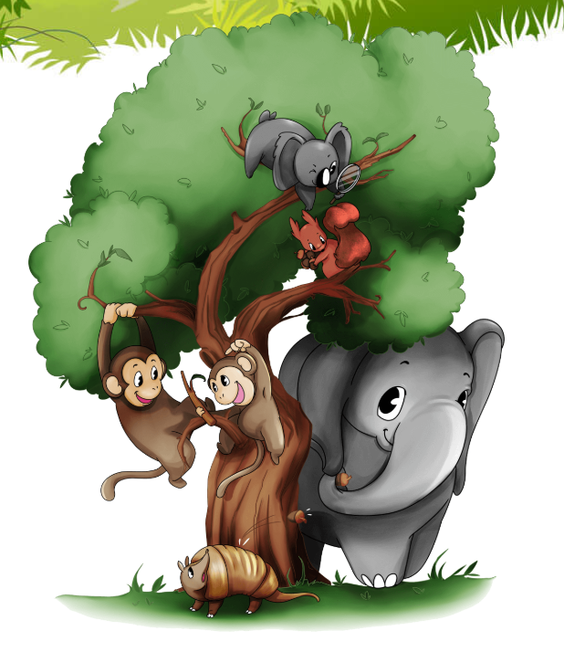
Metacognition: our learning jungle animals
Help to support your children with positive learning behaviours.

Slide 2
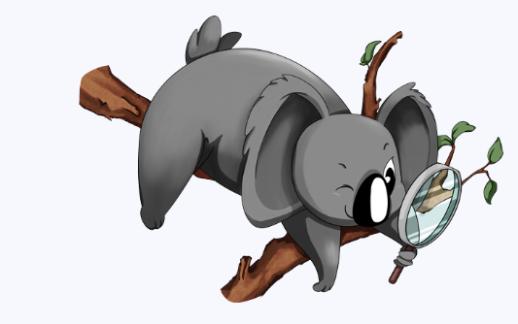
Kelly the koala
I ask questions
I look for patterns
I like to be curious.
I notice and spot things

Slide 3
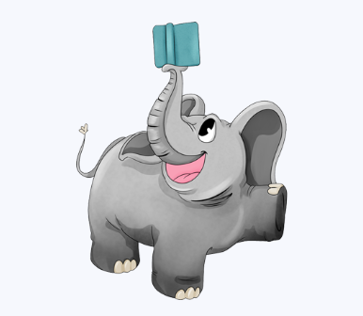
Emily the elephant
I don’t get distracted
I like to concentrate
I can stay focussed

Slide 4
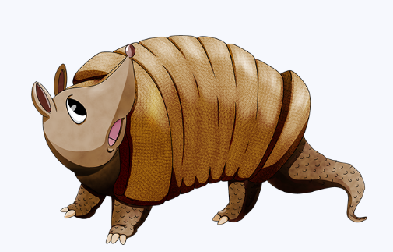
I’m resilient
Albert the armadillo
I have another go and try again
I learn from my mistakes
I don’t give up
I try to improve things

Slide 5
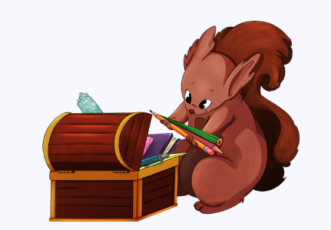
Sadie the squirrel
I like to co operate
I listen to others
I am kind when I disagree
I take turns
I explain or help others

Slide 6
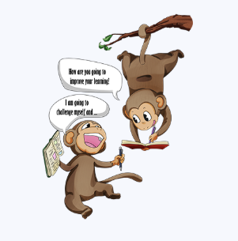
The monkeys
I like to keep on improving
I take small steps
I improve one thing at a time
I try to get better each time

